Slide 1
Adverse Childhood Experiences (ACE) Kentucky Behavioral Risk Factor Survey 2015
Connie Gayle White, MD, MS, FACOG
Senior Deputy Commissioner
Kentucky Department for Public Health

Slide 2
Critical Periods
Birth – 2 years; critical window for hardwiring the brain for social-emotional development.
Social-Emotional development is based on secure attachment and becomes the foundation for cognitive development and sense of self-identity.
Attachment comes from a nurturing relationship with a caregiver that is consistent and caring.
Notes:
The brain is built by connections
from the ground up like a house
A weak foundation can lead to
compromised function
Simple connections for complex circuits over time with
appropriate reinforcement
The first three years of life are the most active with 700-1,000
new connections per second

Slide 3
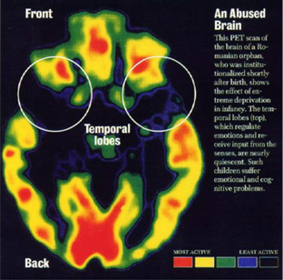
Critical Periods
The Two Year window – results of extreme deprivation of stimulation
Notes:
Abnormal Stress hormone Levels
US Middle Class Toddlers in Birth Families 5%
Neglected/Maltreated Toddlers/Overseas Orphanages 30%
Gunnnar and Firsher (2006) Harvard Center
for the Developing Child

Slide 4
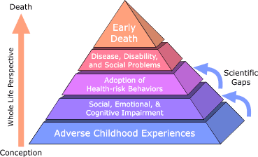

Slide 5
Kentucky Behavioral Risk Factor Survey (KyBRFS)
Eleven questions about adverse childhood experiences (ACE) were added in the 2015 Kentucky Behavioral Risk Factor Survey (KyBRFS).

Slide 6
ACE Module
Comprised of 11 questions that assess the following eight categories of ACE:
Childhood Abuse
Physical abuse
Sexual Abuse
Emotional Abuse
Household Dysfunction
Presence of a mentally ill household member
Alcohol or drug abuse in the household
Incarcerated household member
Violence between adults in the household
Parental divorce or separation

Slide 7
Prevalence of ACE Among Some States in the US
STATE | % of Adults with at least 1 ACE | % of adults with 4 or more ACE
California | 61% | 16.7%
Iowa | 55% | 14%
Kentucky | 59% | 17.5%
Minnesota | 55% | 13%
Montana | 61% | 17%
Vermont | 57% | 13%
Washington | 62% | 17%
Wisconsin | 56% | 14%
Notes:
Data Source = BRFSS

Slide 8
Prevalence of Adverse Childhood Experiences (ACE) among Kentucky adults ages 18 and older by ACE Score, KyBRFS 2015
Notes:
Self-reported exposure to any single ACE category is counted as one point toward the final ACE score (range: 0 to 8)

Slide 9
Prevalence of Adverse Childhood Experiences (ACE) among Kentucky adults ages 18 and older by ACE Score, KyBRFS 2015
Notes:
Self-reported exposure to any single ACE category is counted as one point toward the final ACE score (range: 0 to 8)

Slide 11
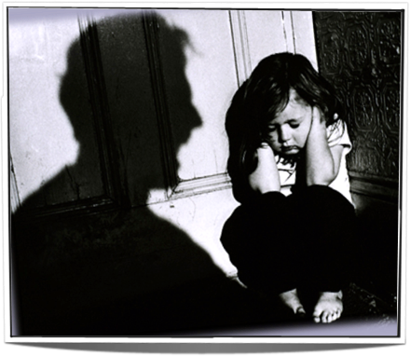
Toxic Stress
Notes:
“Amydgala Hijack”-toxic stress
•Impaired memory esp. working and contextual
•Inability to concentrate
•Hard to follow directions
•Hard to sit still
•Constantly on edge
•Easily provoked
•Impulsive

Slide 12
ACEs and Kentucky Children 2011-2012 National Survey of Children’s Health
30% of KY children with ACE>=2 (22.6% nationally)
1:5 KY children experience >=2 ACE by age 5 (1:8 nationally)
KY children with ACE scores >=3, one of the highest rates in the country
2014 KY Kids Count Data Book

Slide 13
Odds for Academic and Health Problems with Increasing ACE in Spokane Children
 | Academic Failure | Severe Attendance Problems | Severe School Behavior Concerns | Frequent Reported Poor Health
Three of more ACE N=248 | 3 | 5 | 6 | 4
Two ACE N=213 | 2.5 | 2.5 | 4 | 2.5
One ACE N=476 | 1.5 | 2 | 2.5 | 2.0
No Known ACE N=1,164 | 1 | 1 | 1 | 1
Washington State 2012

Slide 14
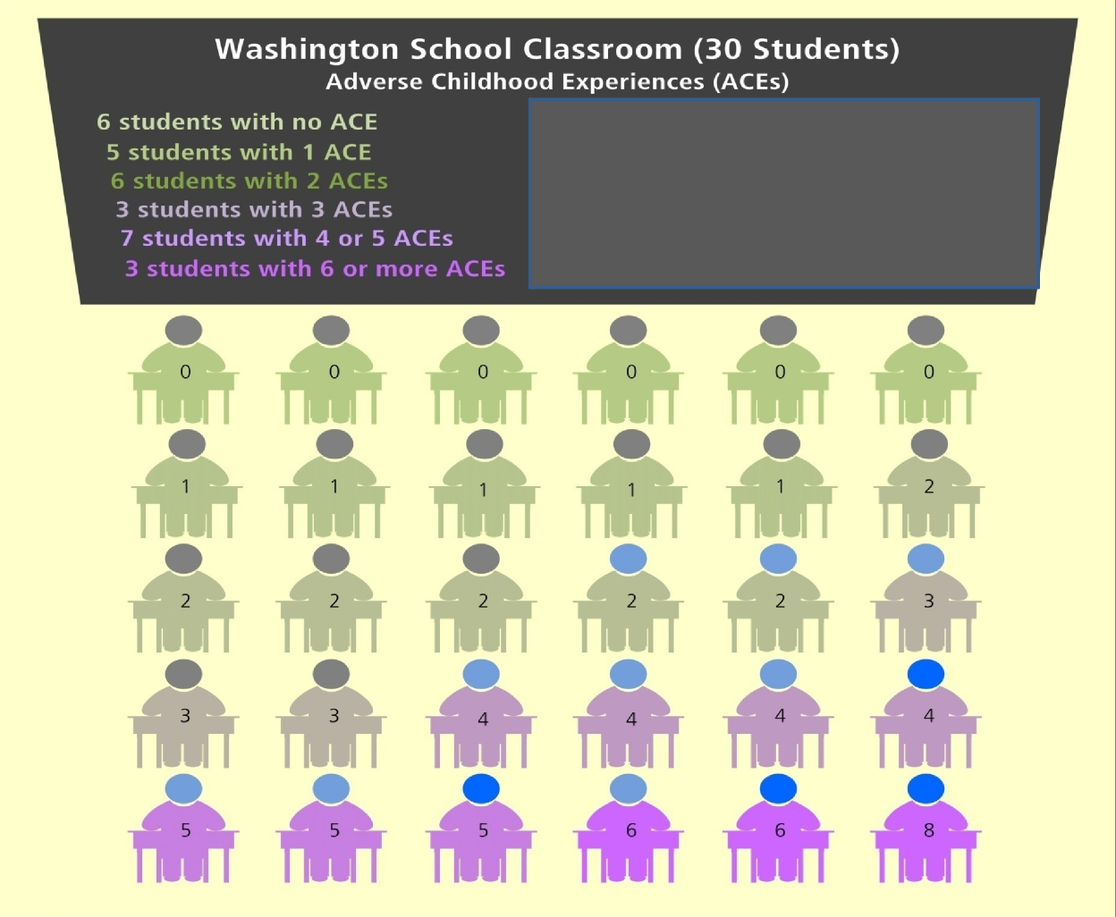
 |  |  |  | ACEs and High School Sophomores and Seniors
 | Population Average
Washington State determined that 13 out of every 30 students will have toxic stress from 3 or more traumatic experiences

Slide 15
ACE Score and Teen Sexual Behaviors
Hillis S et al, 2001

Slide 16
ACE Score and Attempting Suicide
During Adolescence
Attempted suicide < = 18 years
Dube et al., JAMA, 2001

Slide 17
Prevalence of selected health risk factors among Kentucky adults aged 18 years and older by ACE score group, KyBRFS 2015

Slide 18
Prevalence of selected chronic conditions among Kentucky adults aged 18 years and older by ACE score group, KyBRFS 2015
Notes:
Almost double for poor/fair general health days

Slide 19
Resilience
Resilience is the ability to overcome serious hardship
The foundation of resilience is the combination of
Supportive relationships
Adaptive skill building
Positive experiences that re-inforce self-efficacy, perceived control, and belonging
Resilience requires relationships
The capabilities that underlie resilience can be strengthened at any age
Harvard Center for the Developing Child. Key Concepts

Slide 20
Every child is one caring adult away from a success story

