Slide 1
Syringe Exchange Data
Current as of: Feb 22nd, 2019
Prepared by Matt Anderson M.Ed
Health Education Coordinator

Slide 2
Starting August 1st all data will be tabulated on a calendar year instead of fiscal year.
This will align our reports with CDC’s standard of measuring data.
The first report in August (August 7th) will reflect this change. All future reports, data reviews and charts/graphs will be based on calendar data.

Slide 3
All data is self-reported by the client, unless specified
Data is updated every Monday and reflects information obtained from the Neo360 data collection system used at the exchange site
Questions about the data can be emailed to matthew.anderson@ky.gov
General questions about the syringe exchange program can be emailed to maria.hardy@ky.gov

Slide 4
Since January 4, 2019
42 unduplicated clients; 927 since program began 7/1/16
4,364 total visits since program began 7/1/16
Averaging 45.5 clients per week since January 4th 2019
Range: 34-63
Averaging 6 New Clients per week since January 4th 2018
Range: 3-9
102.1% of syringes dispensed to existing clients were returned since January 4th 2019 * Many existing SEP clients return extra syringes each week boosting our return rate over 100%*
89.6% of syringes dispensed to new and existing clients were returned since January 4th 2019.
1,680 clean syringes were dispensed to 42 new clients
89.3% of clients have been to the Exchange 2 or more visits
53.9% have been 10 or more times
29.9 have been 20 or more times

Slide 5
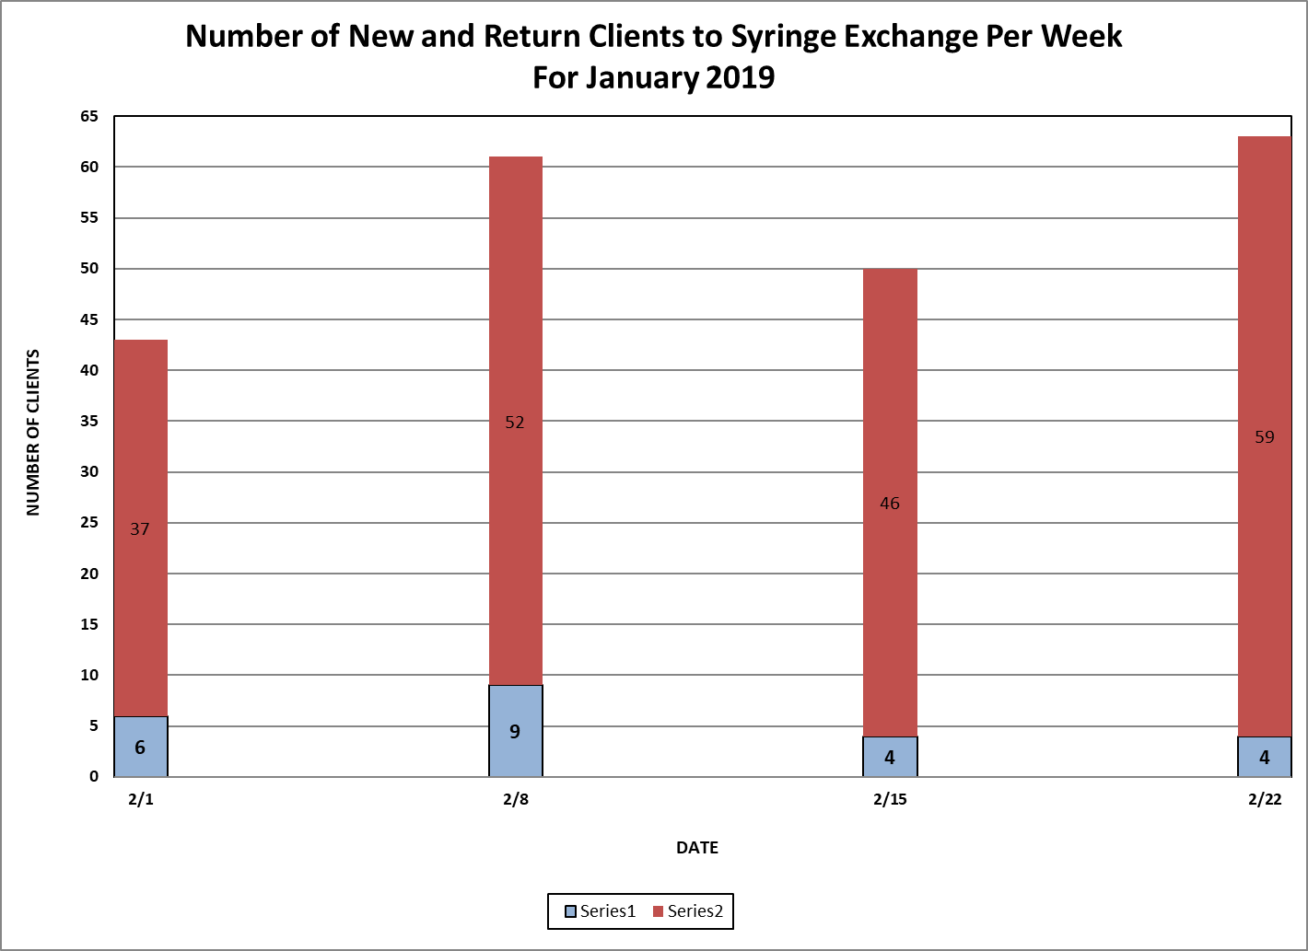

Slide 6
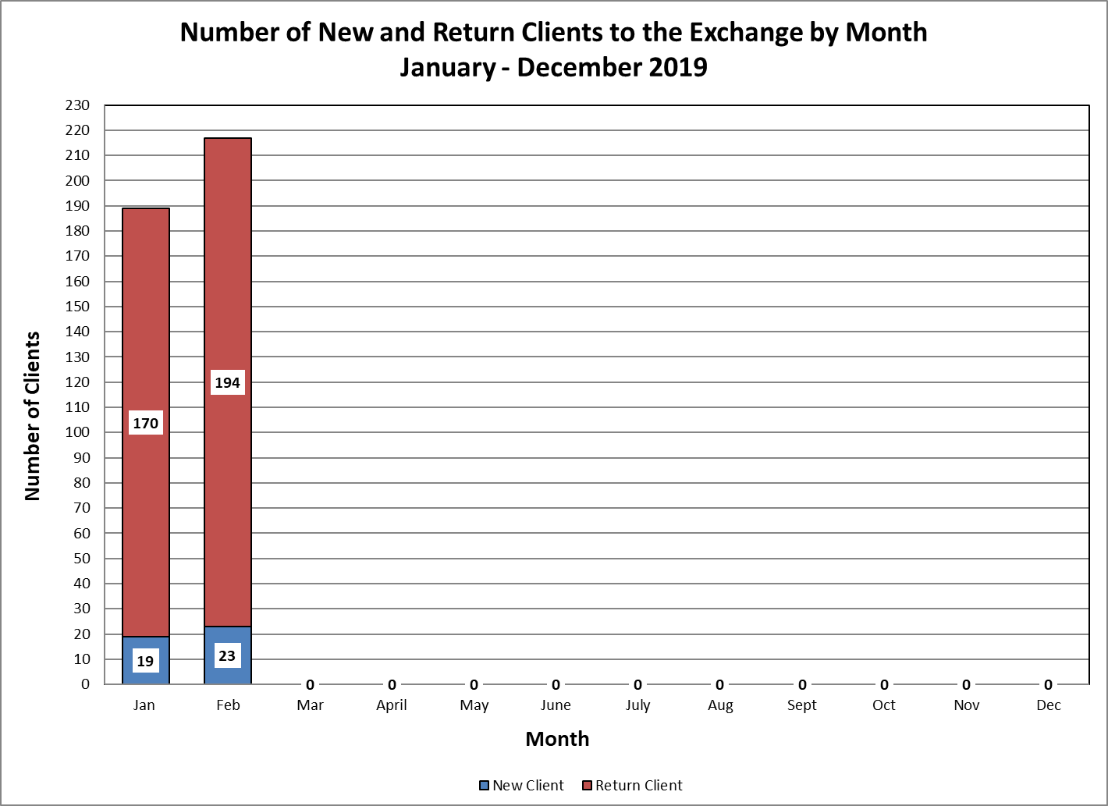

Slide 7
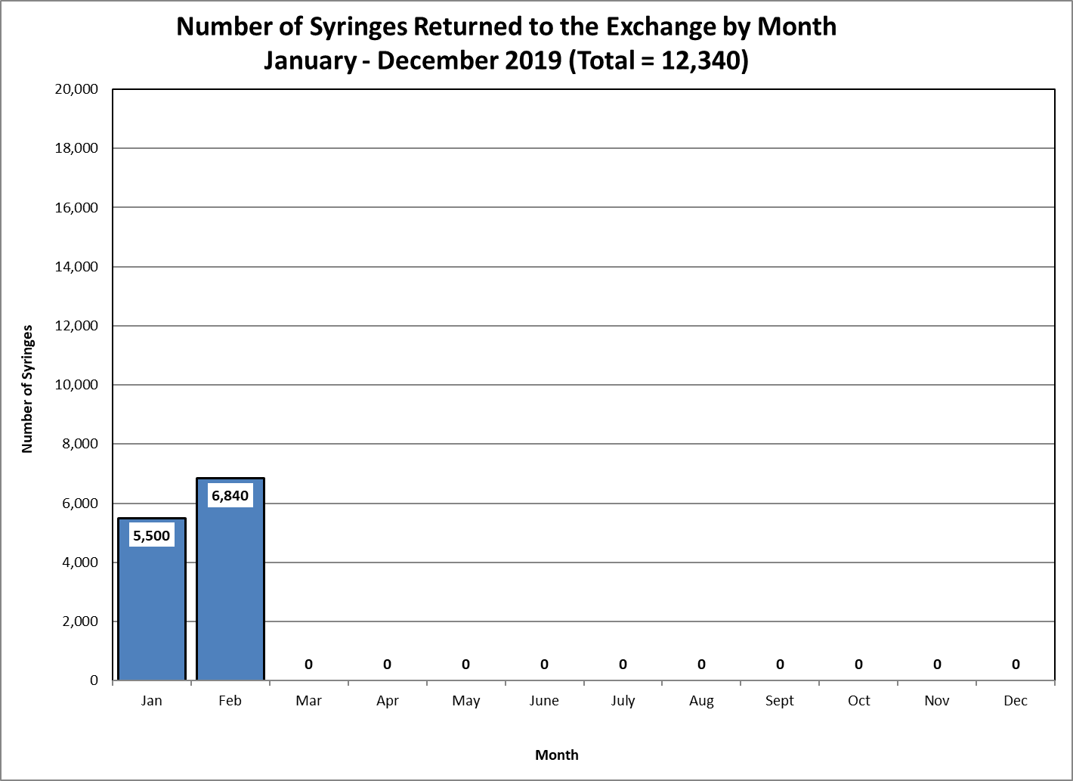

Slide 8
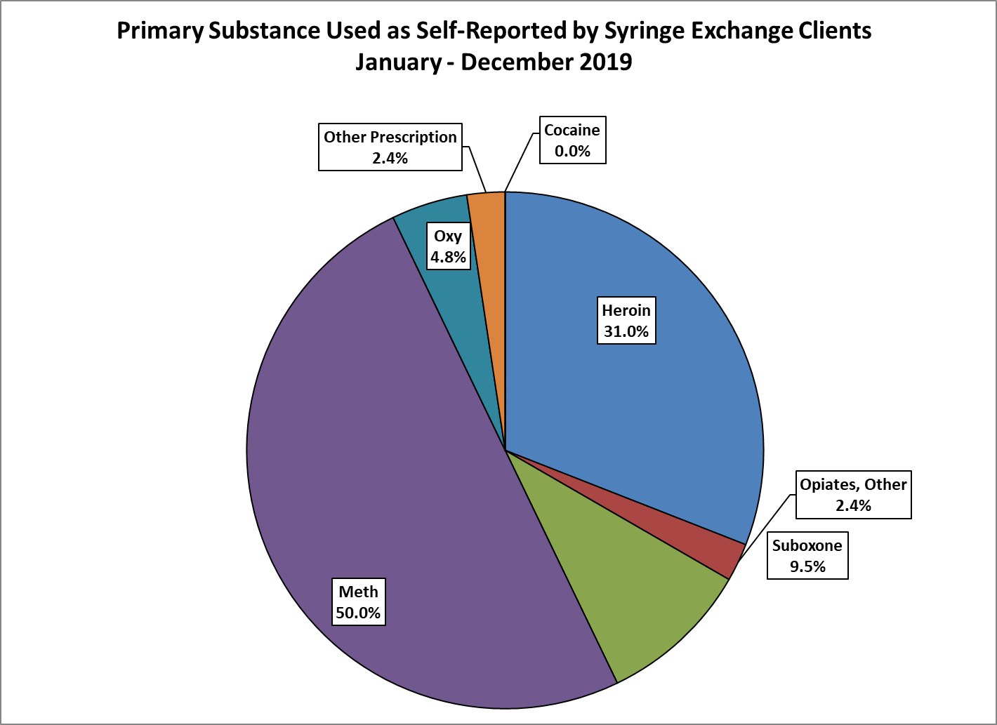

Slide 9
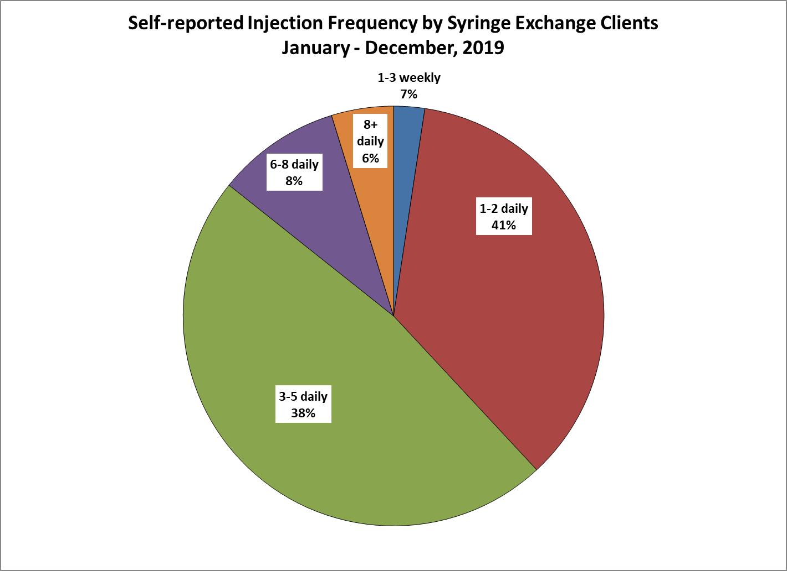

Slide 10
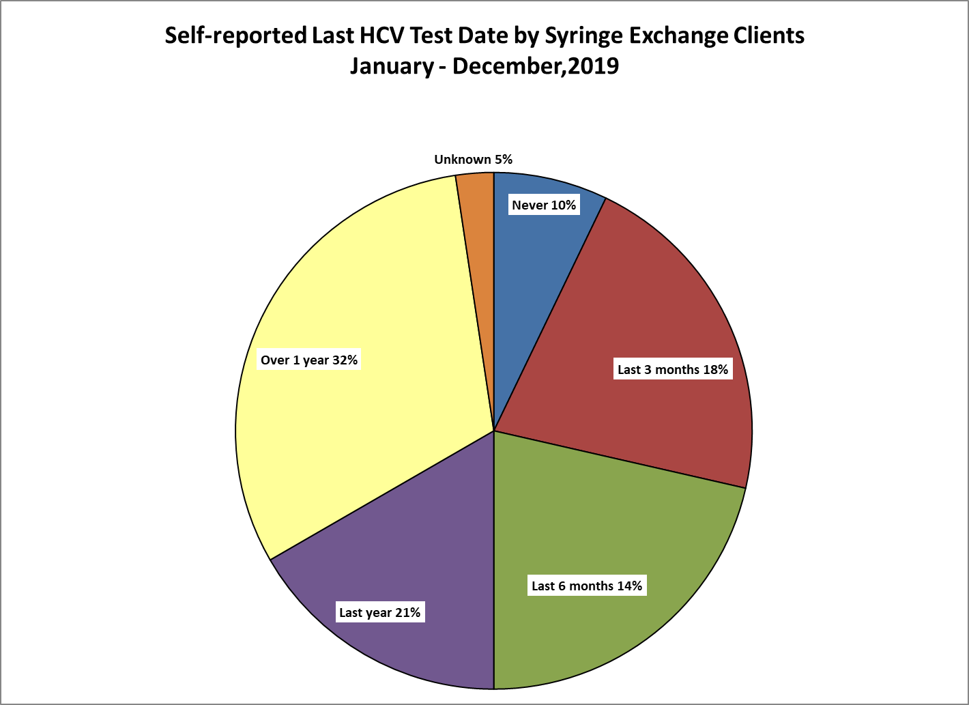

Slide 11
