Slide 1
Households & Registration
Topic #1 – Households and Registration

Slide 2
Topics
Household/Registration Demo
Documenting estimated income
Documenting physical presence
LEP & Language
Transfers and VOCs
Patient ID changes/merges
WIC Inquiry
Encounter Entry

Slide 3
Household and Registration Demo
Day 2 - Topic #1 – Households and Registration

Slide 4
Transfers and VOCs
Day 2 - Topic #1 – Households and Registration

Slide 5
Transfers
Purpose
Move WIC Participant from one household to another within the same County.

Slide 6
Transfers
Child – Very Windy is currently with her aunt Momma Cloudy but is going to move back home with Awful Windy, her mother.

Slide 7
Household Member Page

Slide 8
Select participant and click TRANSFER

Slide 9
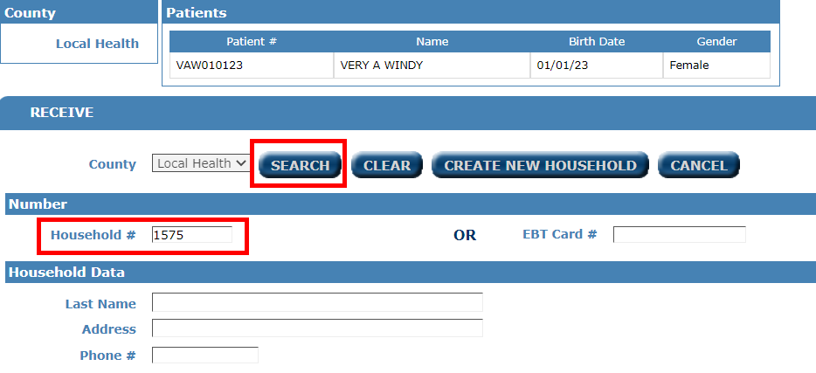
Search for the receiving Household

Slide 10
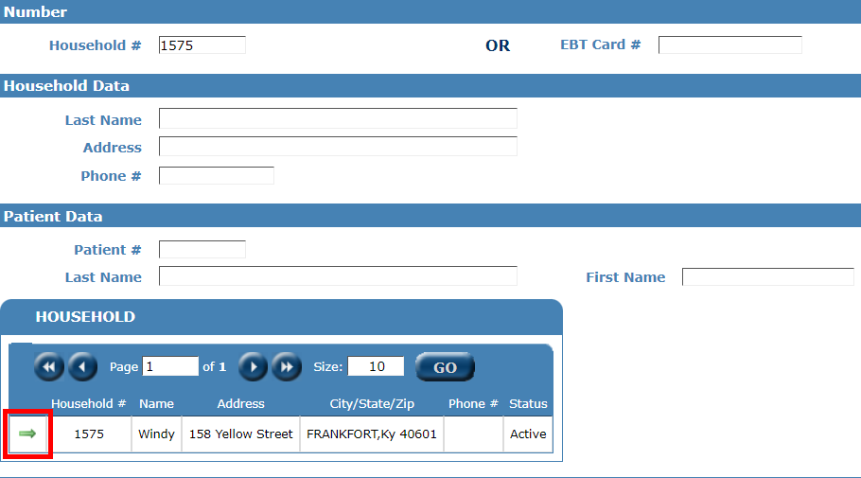
Household found, click GREEN arrow

Slide 11
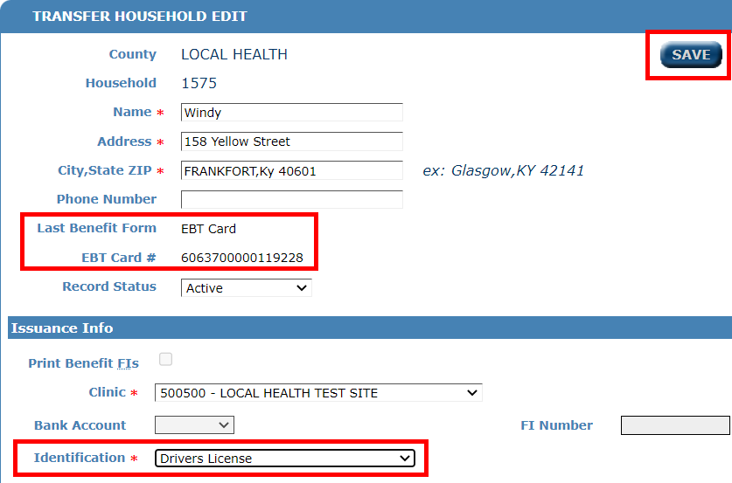
Select ID and click Save

Slide 12
Benefit List of what is transferred

Slide 13
After clicking Save, you will return to WINDY household member page.

Slide 14
Very Windy is now with Awful Windy

Slide 15
VOCs
Purpose
WIC participants move from a different county to your county and have an active certification.

Slide 16
VOC – In state
Mom & Child – Awful and Very Windy have moved to Livingston county. Both have active certifications.

Slide 17
On Portal Menu, click VOC SEARCH

Slide 18
Enter participant’s name and DOB

Slide 19
Search finds Awful Windy

Slide 20
Click the GREEN arrow

Slide 21
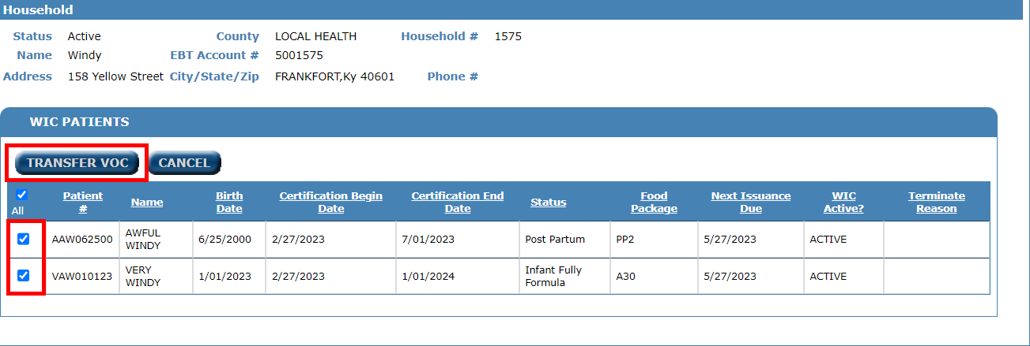
Select the participants, click TRANSFER VOC

Slide 22
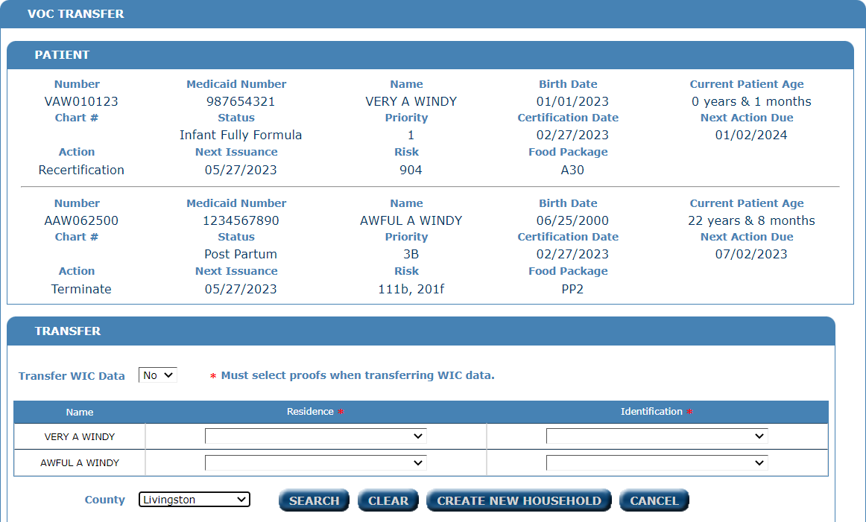

Slide 23
Transfer WIC Data = YES, set Proofs, set your county, and click CREATE NEW HOUSHOLD

Slide 24
Transfer WIC DATA = YES

Slide 25
Are you sure?

Slide 26
Change Household Information

Slide 27
EBT Card seems to be coming with them

Slide 28
Set the Clinic and Identification

Slide 29
Click SAVE or Click SAVE & EBT CARD ISSUANCE

Slide 30
New Household

Slide 31
Issue New EBT Card

Slide 32
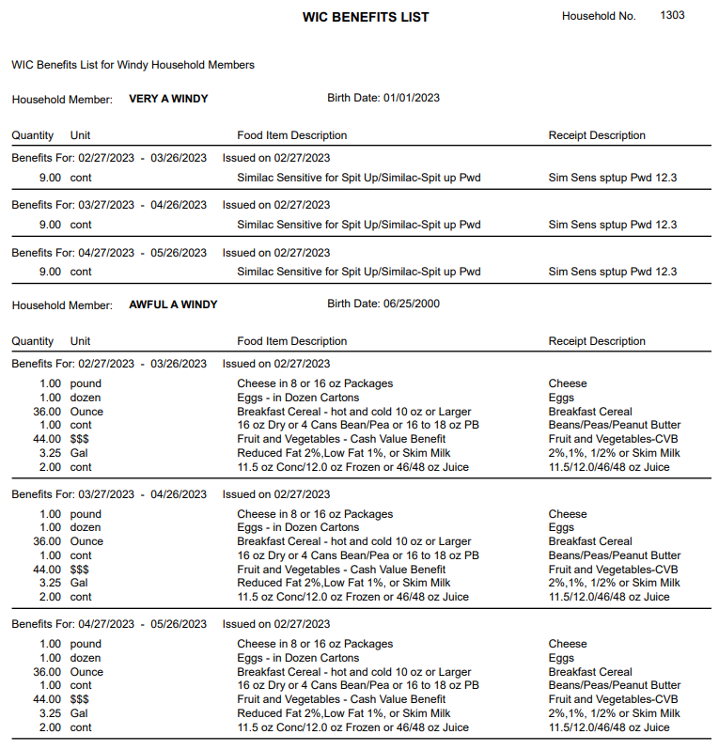
Benefit List

Slide 33
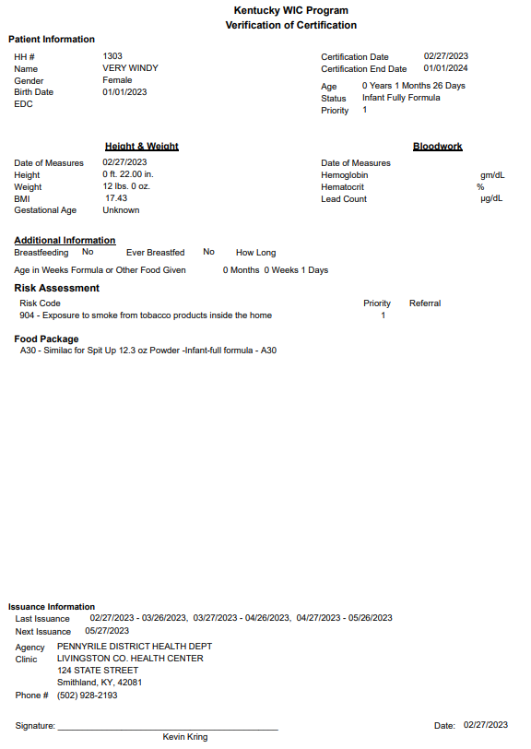
VOC Info

Slide 34
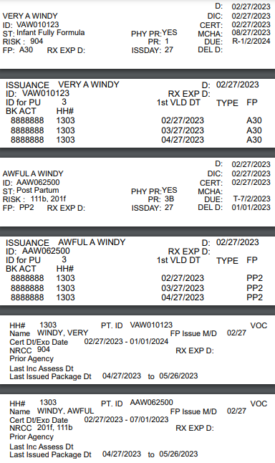
Labels Issuance VOC

Slide 35
VOC – Out of state
Mom & Child – Sunny and Stormy Morning have moved to Livingston county from Nebraska. Both have active certifications.

Slide 36
Search for Household, click NEW HOUSEHOLD

Slide 37
Build Household & SAVE

Slide 38
Add members & SAVE

Slide 39
Register each member

Slide 40
Complete Registration, Click SAVE & VOC

Slide 41
Capture Certification info

Slide 42
When the status is entered, the VOC risk will show

Slide 43
Click SAVE & FOOD PACKAGE

Slide 44
Assign Food Package

Slide 45
Workflow Differences
Some clinics, if they are assigning a standard food package, front-end staff will assign the package.
Some clinics, front-end staff don’t set the food package, and save without setting a package. The health professional will then set the food package.

Slide 46
And finally,
Issue an eWIC Card
Issue benefits
Schedule next appointment

Slide 47
Patient ID Change/Merge
Day 2 – Topic #1 – Household and Registration

Slide 48
Patient ID Change
Topic #1

Slide 49
Patient ID Change
Definition
A patient ID change is for changing a patient’s ID from one value to another. When the patient’s record was built, it was entered incorrectly.
The patient only has ONE patient ID.

Slide 50
Select County from the County drop-down

Slide 51
Select CHANGE from the Action drop-down

Slide 52
Enter INCORRECT ID in Patient # to update

Slide 53
Enter CORRECT ID in Update Patient # to

Slide 54
Enter INCORRECT ID in Confirm Patient # to update

Slide 55
Enter CORRECT ID in Confirm Update Patient # to

Slide 56
Click COMPLETE

Slide 57
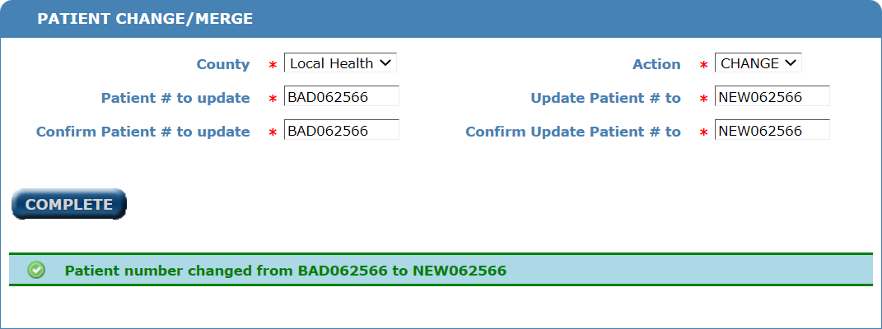
All Done

Slide 58
Patient ID Merge
Day 2 - Topic #1 – Household and Registration

Slide 59
Patient ID Merge
Definition
A patient has 2 or more patient IDs. The merge will take the two IDs and MERGE them into 1 record.
This action CAN’T be undone!

Slide 60
Patient ID Merge
Conditions
Date of Birth, Gender, and Race must be the same
Neither Patient can have active WIC benefits
This action CAN’T be undone!

Slide 61
Select County from the drop-down

Slide 62
Select MERGE from the Action drop-down

Slide 63
Enter INCORRECT ID in Patient # to update

Slide 64
Enter CORRECT ID in Update Patient # to

Slide 65
Enter INCORRECT ID in Confirm Patient # to update

Slide 66
Enter CORRECT ID in Confirm Update Patient # to

Slide 67
Click COMPLETE

Slide 68
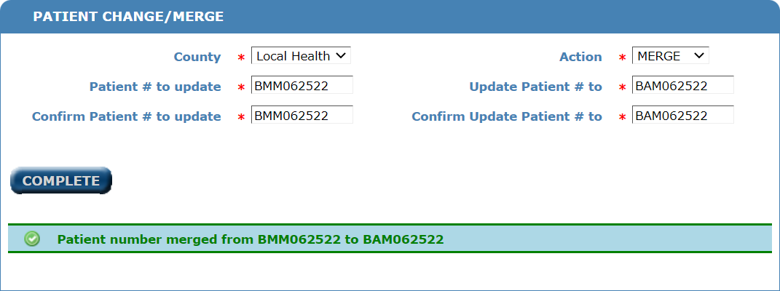
ALL DONE

Slide 69
WIC Inquiry
Day 2 - Topic #1 – Households and Registration

Slide 70
Household Page

Slide 71
WIC Inquiry

Slide 72
Encounter Entry
Day 2 - Topic #1 – Households and Registration

Slide 73
From Household page

Slide 74
From Patient Menu, click PEF Listing

Slide 75
On PEF, set the LEP flag

Slide 76
Any Questions?
Day 2 - Topic #1 – Households and Registration

