Slide 1
Biologics in the Treatment of Severe Asthma
Mark L. Corbett, M.D.
Family Allergy
Immediate Past President ACAAI

Slide 2
Disclosures
Practice- Family Allergy
Speaker Bureau- None
Advisory panel – Astra Zeneca Inc, Alk Inc, Takeda Inc, Abbvie Inc, Regeneron Inc, Blueprint Inc, Bryn Inc

Slide 3
Learning Objectives
Upon completion, learners should understand pathophysiology of T2 phenotype in asthma
Upon completion, learners should understand classification of severe asthma
Upon completion, learners should understand current available biologics for asthma
Upon completion, learners should understand use of biomarkers in guiding selection of biologic
Upon completion, learners should understand information on switching or combining biologics in asthma
Upon completion, learners should understand whether biologics are curative

Slide 4
Biologics in Asthma
Pathophysiology of Asthma
What is severe asthma?
Current biologics
How to choose therapy
Switch therapy
Combine therapy and are biologics curative
Cases

Slide 5
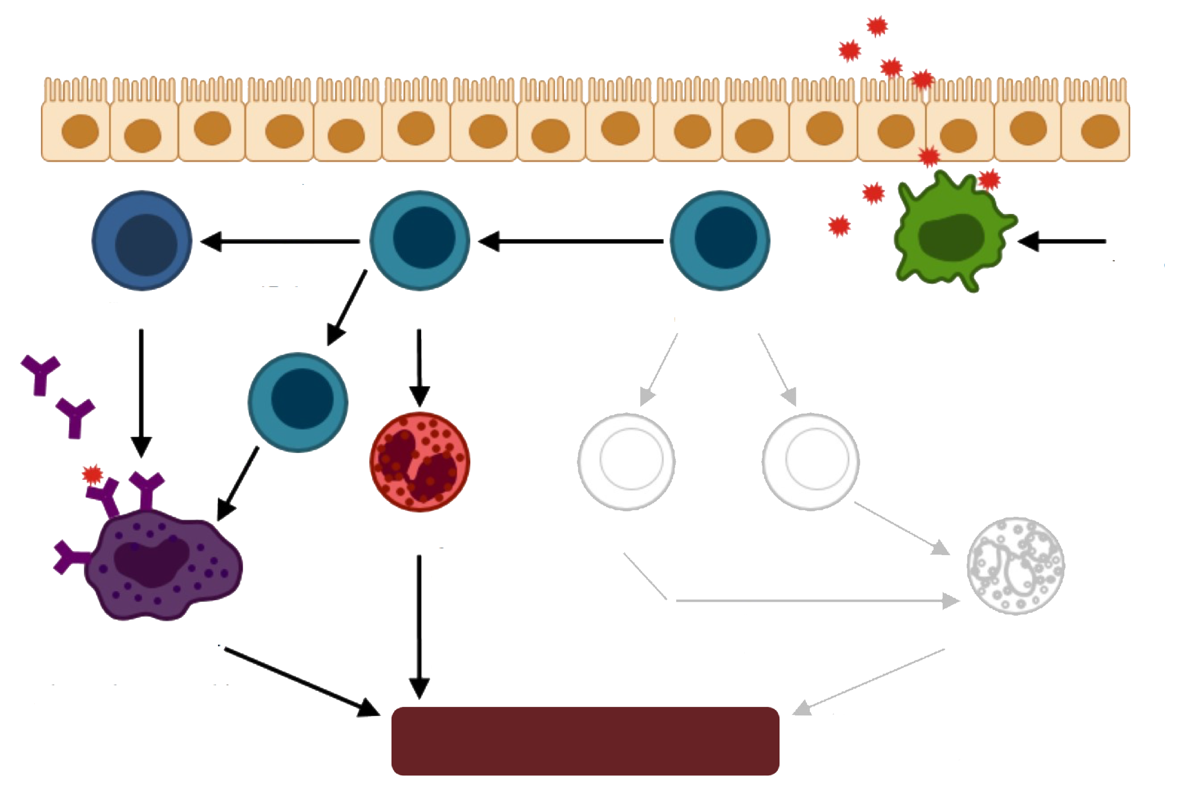
T2-Mediated Inflammation
Allergens
IL-4
IL-13
IL-25
IL-33
TSLP
IL-4
IL-4
TGFβ
B cell
Th2 cell
Th0 cell
Dendritic cell
IL-12
IFNy
IL-6
TGFβ
IgE
IL-9
Eosinophil
Th1 cell
Th17 cell
Cysteinyl
leukotrienes
Basic proteins
Cytokines
Mast cell
TNFα
IFNy
Neutrophil
Histamine, Cytokines
Prostaglandins, Cysteinyl
leukotrienes
MMP
Neutrophil elastase
ROS
Airway remodeling
Pelaia G, et al. Drug Design Dev Ther. 2017;11:1979-1987; Parulekar AD, et al. Curr Opin Pulm Med. 2016;22:59-68.

Slide 6
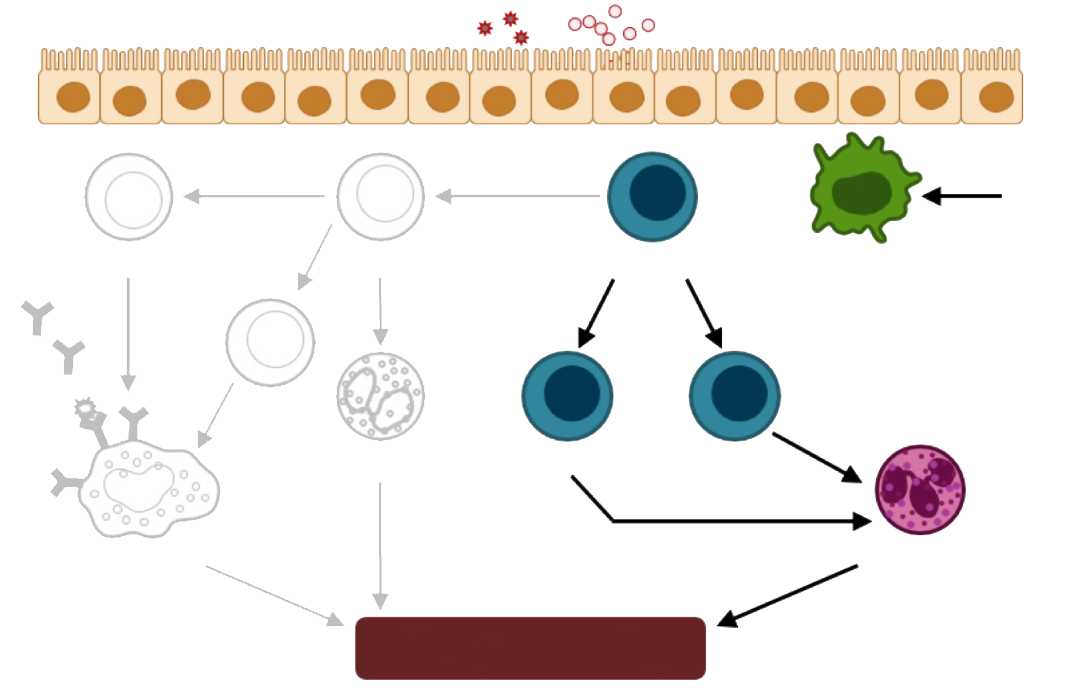
Non-T2-Mediated Inflammation
Pollutants, microbes, glycolipids
IL-4
IL-13
IL-25
IL-33
TSLP
IL-4
IL-4
TGFβ
B cell
Th2 cell
Th0 cell
Dendritic cell
IL-12
IFNy
IL-6
TGFβ
IgE
IL-9
Eosinophil
Th1 cell
Th17 cell
Cysteinyl
leukotrienes
Basic proteins
Cytokines
TNFα
IFNy
Neutrophil
Mast cell
Histamine, Cytokines
Prostaglandins, Cysteinyl
leukotrienes
MMP
Neutrophil elastase
ROS
Airway remodeling
Pelaia G, et al. Drug Design Dev Ther. 2017;11:1979-1987; Parulekar AD, et al. Curr Opin Pulm Med. 2016;22:59-68.

Slide 7
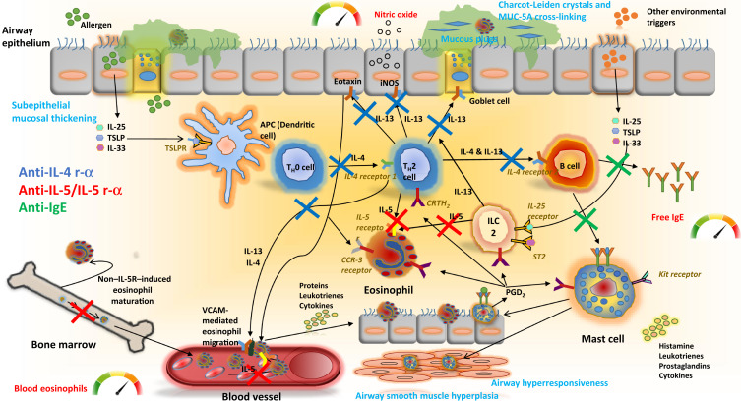
Anti TSLP

Slide 8
Eosinophil as an Inflammatory Biomarker
Variable numbers of blood and airway eosinophils are present in patients with type 2 cytokine profiles
  Likely relates to level of type 2 activation
Eosinophils in blood and airway are correlated with:
  Frequency of asthma exacerbations
  Degree of airflow limitation
  Presence and severity of chronic rhinosinusitis/nasal polyposis

Slide 9
Blood Eosinophil Counts Correlate With
Risk of Asthma Exacerbations
Claims database analysis examining eosinophil count and exacerbations
requiring systemic CS or ER/hospital care
Eosinophil Stratum | Severe Exacerbations Relative Risk
201–300 cells per µL (n=25,882) | .8
301–400 cells per µL (n=15,030) | 1.1
401–500 cells per µL (n=8659) | 1.2
501–600 cells per µL (n=4928) | 1.4
601–700 cells per µL (n=2726) | 1.6
701–800 cells per µL (n=1631) | 1.5
801–900 cells per µL (n=947) | 1.6
901–1000 cells per µL (n=1019) | 2.1
>1000 cells per µL (n=1019) | 2.4
Adapted from Price DB, et al. Lancet Respir Med. 2015;3:849-858.
Notes:
Full Reference
Price DB, Rigazio A, Campbell JD, et al. Blood eosinophil count and prospective annual asthma disease burden: a UK cohort study. Lancet Respir Med. 2015;3(11):849-58. doi: 10.1016/S2213-2600(15)00367-7.

Slide 10
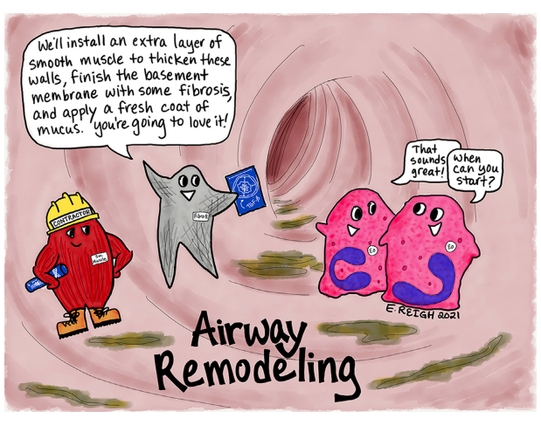

Slide 11
Biologics in Asthma
Pathophysiology of Asthma
What is severe asthma?
Current biologics
How to choose therapy
Switch therapy
Combine therapy and are biologics curative
Cases

Slide 12
Beyond First Line Therapies for Recalcitrant Asthma
ERS/ATS Guidelines for Severe Asthma¹
2018 Global Initiative for Asthma (GINA) Guidelines²
  Severe asthma is asthma that requires Step 4 or 5 treatment, e.g. high-dose ICS + LABA, to prevent it from becoming uncontrolled or asthma that remains uncontrolled despite this treatment.
Allergy/Pulmonary Panel Consensus
  Asthma that requires high dose ICS + LABA + additional controller medications to prevent it from being uncontrolled or asthma that remains uncontrolled despite adherence to this treatment.
ERS, European Respiratory Society; ATS, American Thoracic Society
1. Chung KF, et al. Eur Respir J 2014;43:343-373; 2. Blaiss M, Castro M, Chipps B, et al. Ann Allergy Asthma Immunol. 2017;119(6):533-540.

Slide 13
Asthma in 2019
Multiple Unmet Medical Needs
Although national and international guidelines for asthma control have been established, current standard-of-care
has yet to meet them^{1,2}
Uncontrolled asthma is associated with significant morbidity and mortality and a high economic burden³
2019 US estimate $80 Billion- CDC
439,000 discharges from hospital inpatient care and 1.8 million emergency department visits each year⁴
5% to 10% of patients have severe asthma,³ and often fail to respond to conventional therapy^{5,6}
1. Bateman ED, et al. Am J Respir Crit Care Med. 2004;170:836-844; 2. Bateman ED, et al. Eur Respir J. 2007;29:56-62;
3. Chipps BE, et al. J Allergy Clin Immunol. 2012;130:332-342; 4. Centers for Disease Control and Prevention.
https://www.cdc.gov/asthma/default.htm. Accessed May 27, 2018; 5. Chung KF, et al. Eur Respir J. 2014;43:343-373;
5. Holgate ST, Polosa R. Lancet. 2006;368:780-793; 6. Partridge MR. Eur Respir Rev. 2007;16:67-72

Slide 14
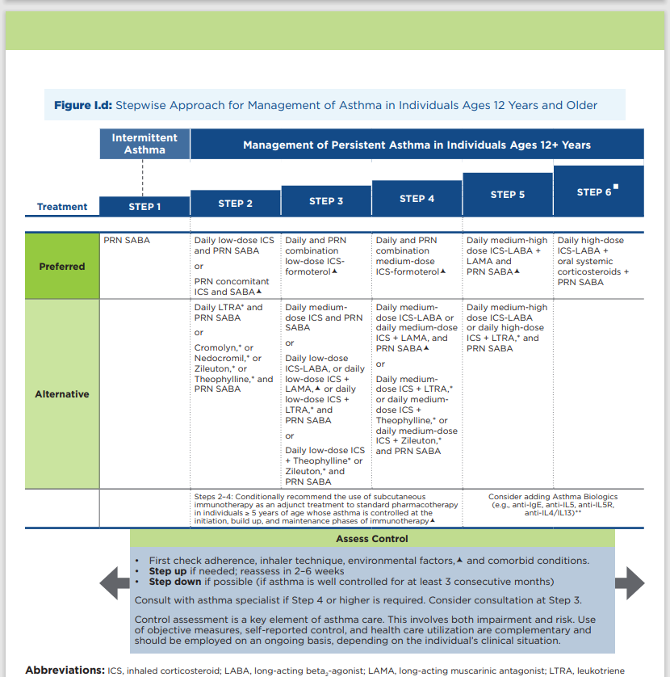

Slide 15
Beyond First Line Therapies for Recalcitrant Asthma
Stage 1-4 patients relatively straight forward, although new emphasis on use of ICS when using rescue bronchodilator
What do we do with the patient who is not doing well despite being prescribed ICS/LABA and +/- LAMA and LTRI?

Slide 16
Before Starting a Biologic
It is essential that, before consideration of initiating a biologic, a comprehensive evaluation be undertaken to :
address the underlying diagnosis of asthma
confounders and mimickers of asthma
coexisting medical and psychosocial conditions
the presence of modifiable exposures, barriers to care, health beliefs, and treatment adherence
inhaler administration techniques

Slide 17
Treatment for the Hard to Control Asthmatic
What medication options are available for the difficult to control patient?
  Oral corticosteroids- Not a long-term option due to safety
  Even short bursts associated with potential complications
  Other immune modulators- Methotrexate, Gold-- ? efficacy
These long-time therapies are no longer viable options with advent of Biologics

Slide 18
Real World Oral Steroid Reduction with Biologic
Kimura et al conducted a retrospective cohort study using self-controlled methods to evaluate the association between the use of biologics and reduction in exacerbations and hospitalizations using a large-scale health insurance claims database in Japan
Of 355 continuously treated asthma patients using biologics, 119, 82, 69, and 85 patients were assigned to the omalizumab, mepolizumab, benralizumab, and dupilumab groups, respectively
The total systemic corticosteroid dose equivalent to prednisolone per person-year was reduced from a median of 600 [interquartile range, 90–1713] mg to 164 [0–1010] mg (P < .001)

Slide 19
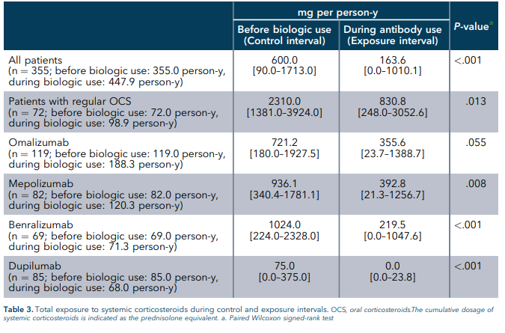
Steroid Use on Biologics- Real World Study

Slide 20
Biologics in Asthma
Pathophysiology of Asthma
What is severe asthma?
Current biologics
How to choose therapy
Switch therapy
Combine therapy and are biologics curative
Cases

Slide 21
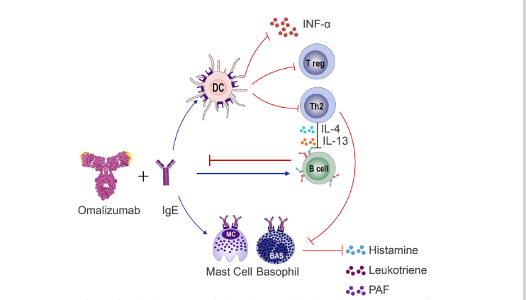
Anti IgE therapy

Slide 22
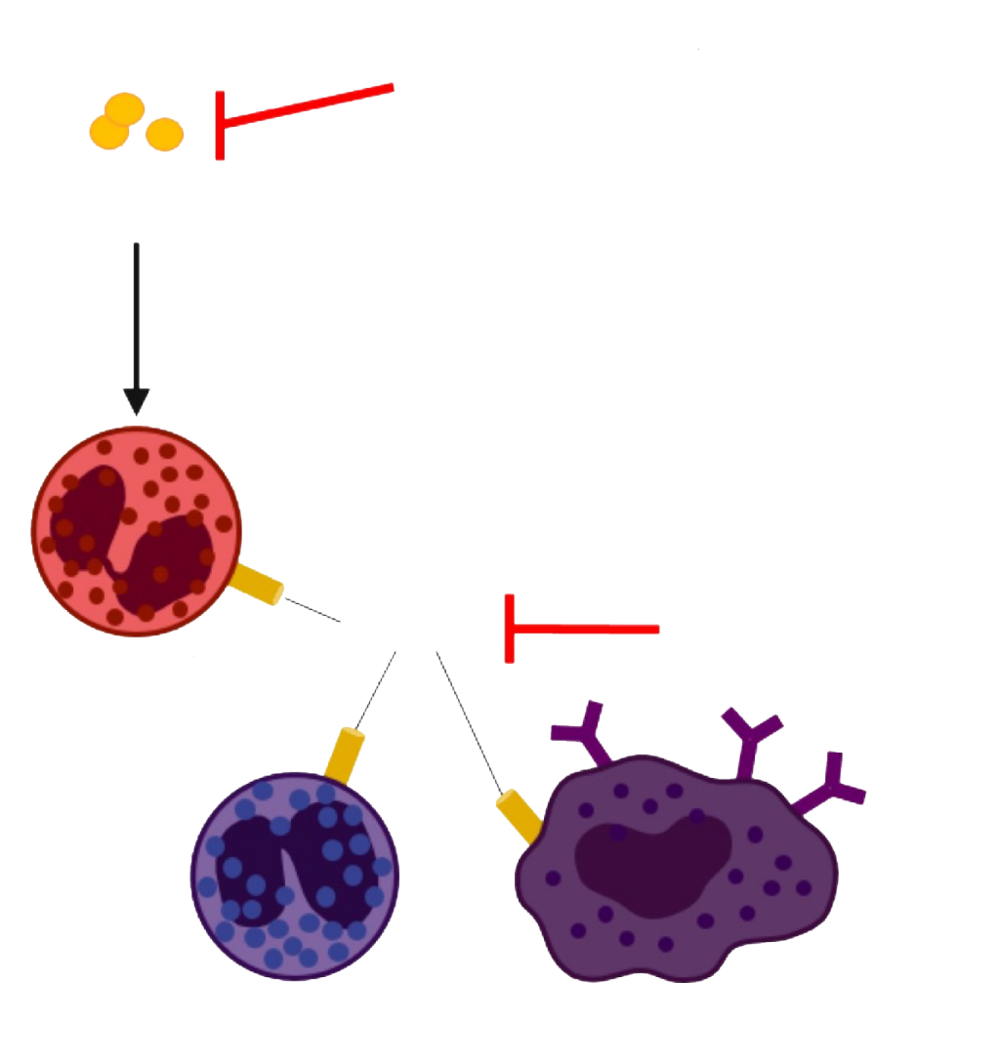
Anti-IL-5 Therapy in Eosinophilic Asthma
Mepolizumab Resilzumab
IL-5
IL-5- targeted agents decrease asthma exacerbations in
patients with
severe asthma
who have high blood
eosinophil levels
IL-5Rα
Benralizumab
Eosinophil
Basophil
Mast cell
Dunn RM, Wechsler ME, Clin Pharmacol Ther. 2015;97:55-65; Ortega H, et al. N Engl J Med. 2014;371:1198-1207;
Castro M, et al. Lancet Respir Med. 2015;3:355-366.

Slide 23
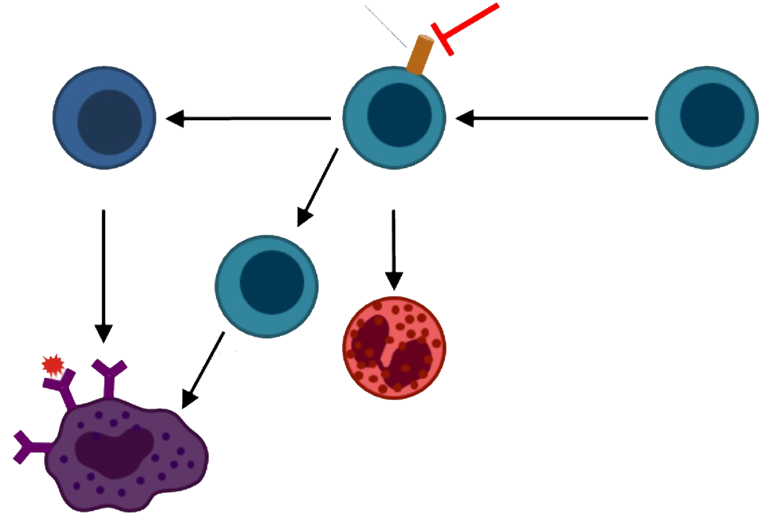
Anti-IL-4/IL-13 Therapy
IL-4Rα
Dupilumab*
IL-4
IL-13
IL-4
IL-4
TGFβ
Anti-IL-4 receptor
therapy blocks
IL-4- and
IL-13-mediated
inflammation
B cell
Th2 cell
Th0 cell
IL-5
IL-9
Th9 cell
Eosinophil
Mast cell
*Dupilumab is not indicated to treat asthma.
Hambly N, et al. Curr Opin Pulm Med. 2014;20:87-94.

Slide 24
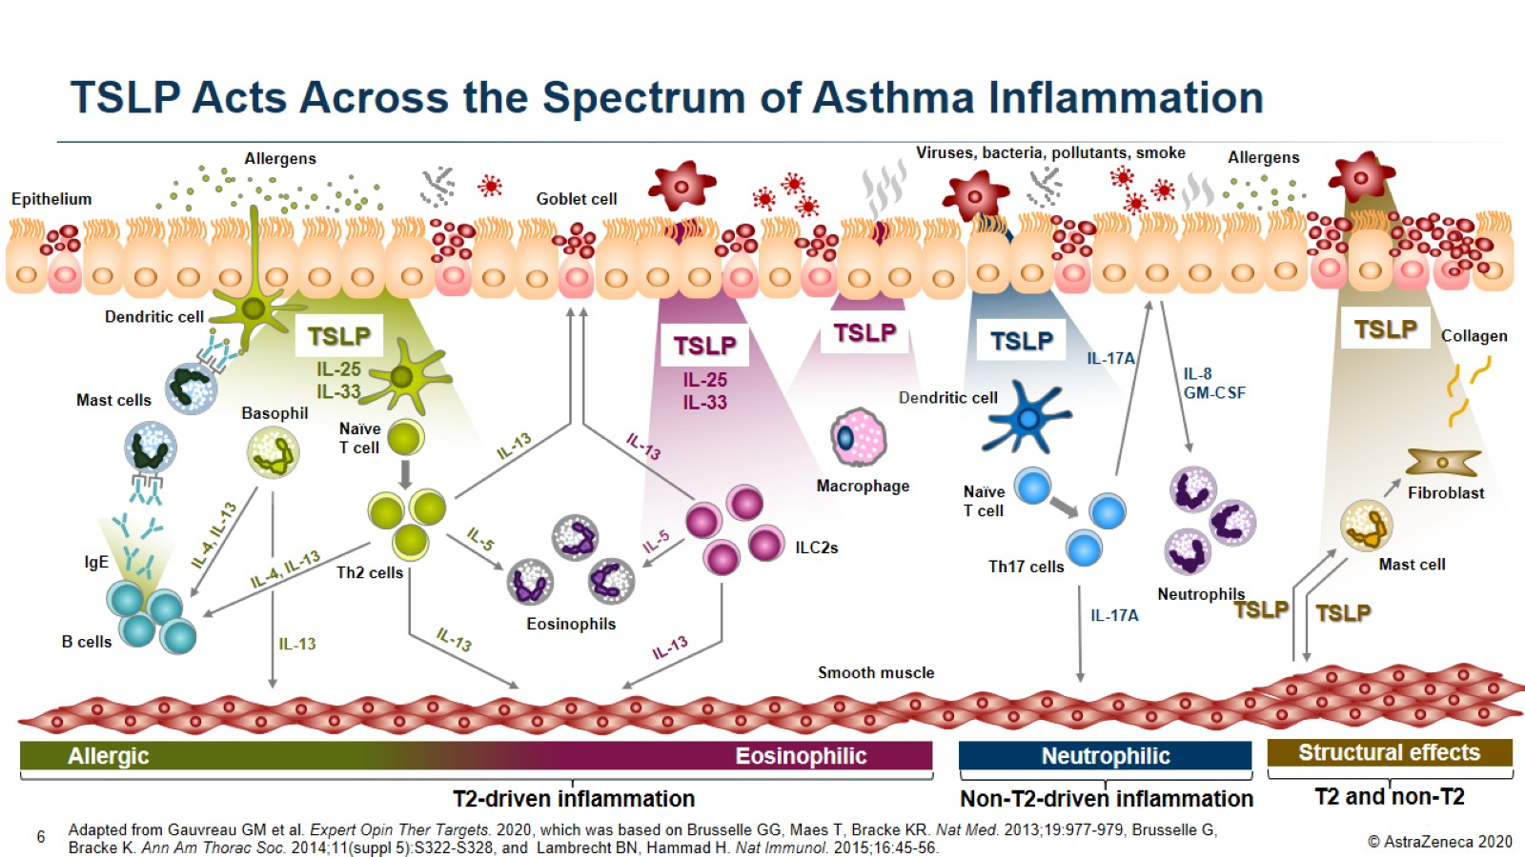
TSLP Acts Across the Spectrum of Asthma Inflammation

Slide 25
Approved Biologic Therapies for Asthma
Omalizumab^{1,2}
Reslizumab^{3,4}
Mepolizumab^{5,6}
Benralizumab^{7,8}
Dupilumab⁹
Severe persistent
allergic phenotype
Severe
eosinophilic phenotype
Severe
eosinophilic phenotype
Severe
eosinophilic phenotype
Moderate or Severe
eosinophilic phenotype and steroid dependent
Indicationª
MoA
Anti-IgE mAb
Anti-IL-5 mAb
Anti-IL-5 mAb
Anti-IL-5Rα mAb
Anti-IL-4Rα mAb
Age
6 years and older
18 years and older
6 years and older
12 years and older
6 years and older
Dosing and administration
SC q2w/q4w by weight; administered in health-care setting
IV q4w by weight; administered in health-care setting
SC q4w; administered by HCP or at home
SC q4w (1st 3 doses) then q8w; administered by HCP or at home
SC q 2w administered at home
Black box warning: Anaphylaxis, presenting as bronchospasm, hypotension, syncope, urticaria, and/or angioedema of the throat or tongue, has been
reported to occur after administration
Hypersensitivity reactions (eg anaphylaxis, angioedema, bronchospasm, hypotension, urticaria, rash) have occurred after administration
Black box warning: Anaphylaxis occurred with reslizumab infusion in 0.3% of patients in placebo-controlled studies
Hypersensitivity reactions (eg anaphylaxis, angioedema, urticaria, rash) have occurred following administration
Hypersensitivity reactions (eg anaphylaxis, angioedema, urticaria, rash) have occurred following administration
Warnings and precautions
1. Xolair (omalizumab) Prescribing Information. South San Francisco, CA: Genentech, Inc. 2017;
2. Xolair (omalizumab). Summary of Product Characteristics. Novartis Europharm Limited, United Kingdom, 2017
3. Cinqair (reslizumab) Prescribing Information. Frazer, PA: Teva Respiratory, LLC. 2016;
4. Cinqaero (reslizumab). Summary of Product Characteristics. Teva Pharmaceuticals Limited, United Kingdom, 2017
5. Nucala (mepolizumab) Prescribing Information. Research Triangle Park, NC: GlaxoSmithKline. 2017;
6. Nucala (mepolizumab). Summary of Product Characteristics. GlaxoSmithKline Trading Services Limited, Ireland, 2017
7. Fasenra (benralizumab) Prescribing Information. Wilmington, DE: AstraZeneca Pharmaceuticals LP. 2017
8. Fasenra (benralizumab) EMA summary of opinion; 2017. Available at: http://www.ema.europa.eu/docs/en_GB/
document_library/Summary_of_opinion_-_Initial_authorisation/human/004433/WC500238040.pdf Accessed May, 2018
9.Dupixent (dupilumab) Prescribing Information. sanofi-aventis U.S. LLC (Bridgewater, NJ 08807) and Regeneron Pharmaceuticals, Inc.
(Tarrytown, NY 10591) Accessed November 2018
^{aAs per ITT population}
EOS, eosinophils; IV, intravenous; mAb, monoclonal antibody; MoA, mechanism of action;
q2w, every 2 weeks; q4w, every 4 weeks; q8w, every 8 weeks; SC, subcutaneous

Slide 26
Tezepelumab
Blocks inflammatory pathway(anti-TSLP) more upstream
Indicated age 12 and up
Appears to work in patient with low Eosinophil counts <150
Did not achieve statistical significance in trial in steroid dependent patients
Adverse event profile similar to other biologics
No head-to-head data with current therapies

Slide 27
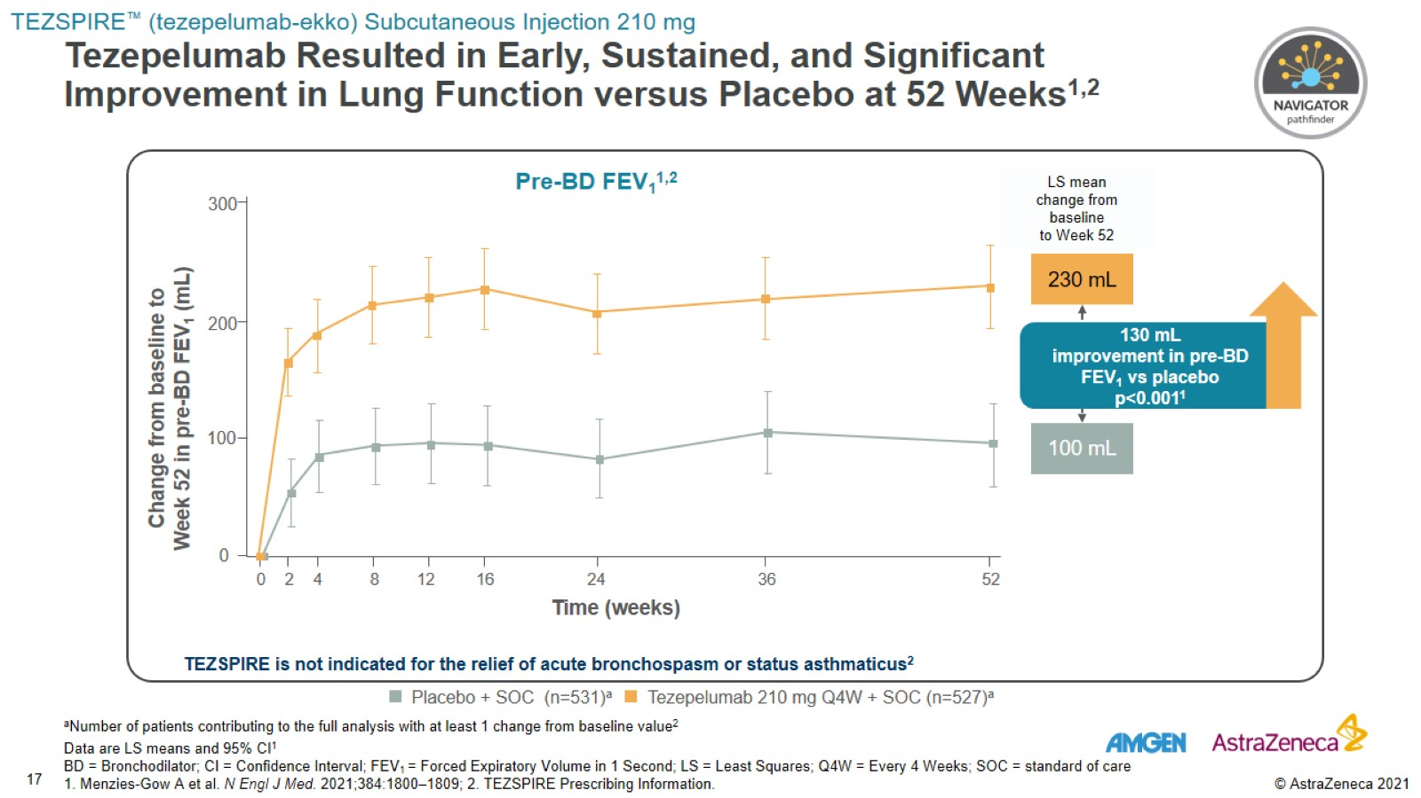
Tezepelumab Resulted in Early, Sustained, and Significant
Improvement in Lung Function versus Placebo at 52 Weeks^{1,2}

Slide 28
Biologics in Asthma
Pathophysiology
What is severe asthma?
Current biologics
How to choose therapy
Switch therapy
Combine therapy and are biologics curative
Cases

Slide 29
How To Choose a Biologic for Your Patient
Biologics work in about 60% of asthma patients-pre Tezepelumab¹
All of the approved biologics work better in patients with higher Eos

Slide 30
Choosing Biologic in Asthma- Algorithm
Buhl et al.-Baseline assessment part 1
Confirm the presence of severe asthma along with OCS dependence or exacerbations 2 per year and T2 inflammation and/or asthma that is clinically allergen driven.
Assess adherence to ICS and other controller medication treatment and reassess the inhaler technique.
Identify and address comorbid disease entities associated with severe asthma and potential exposure to risk factors or complicating factors

Slide 31
Choosing Biologic in Asthma Algorithm
Baseline assessment part 2
If severe asthma diagnosis is confirmed and treatment has been optimized, establish BEC and FeNO levels

Slide 32
Choosing Biologic in Asthma Algorithm
Baseline assessment part 3
Validate T2 biomarker levels by reviewing historic values and performing repeated measures (especially if the adherence/inhaler technique has been addressed)
Confirm the presence/activity of T2 asthma and comorbid disease entities associated with severe asthma.

Slide 33
Choosing Biologic in Asthma
Baseline assessment part 4
In considering comorbid disease entities associated with severe asthma, the highest clinical need of the patient should be addressed.

Slide 34
Biologics in Asthma Algorithm
Choosing therapy-Buhl et al suggest approach
Eos <150
    For patients with FeNO <25ppb and perennial allergen which is confirmed to flare asthma- consider anti-IgE
    For patients with FeNO 25 ppb and confirmation of perennial allergy along with a clear history of confirmed allergy-provoked asthma symptoms, treatment with anti-IL-4/13 or anti-IgE is recommended
    Anti- TSLP may be best choice but not considered in article?

Slide 35
Choosing Biologic in Asthma
Eos >150 and <1500
  For patients with high BEC and high FeNO levels, treatment with either anti-IL-5/5Ra or anti-IL-4/13 should be considered
    For patients with high BEC to FeNO levels (with high BEC being the predominant signal), treatment with anti-IL5/5Ra is recommended
    For patients with high FeNO to BEC levels (with high FeNO being the predominant signal), treatment with antiIL-4/13 is recommended
    For patients with BEC 150 to 1500 cells/mL, also consider the presence/activity of comorbid disease entities associated with severe T2 asthma(AD, Nasal polyp)

Slide 36
Choosing Biologic in Asthma
Eos >1500 cells/mL
First determine potential reasons why BEC is elevated to this level
If it has been determined that the patient does not have an alternative explanation for the eosinophilia, then treatment with anti-IL-5/ 5Ra is recommended.

Slide 37
Choosing Biologic in Asthma
Biologic treatment choice should be made by first taking into consideration BEC and FeNO levels.
Of patients with severe asthma, up to 70% have elevated BEC
FeNO 50 ppb in adults or 35 ppb in children is an indicator of T2 inflammation

Slide 38
What Occurred in Clinical Trials?
All of the approved biologics work better in patients with higher Eos

Slide 39
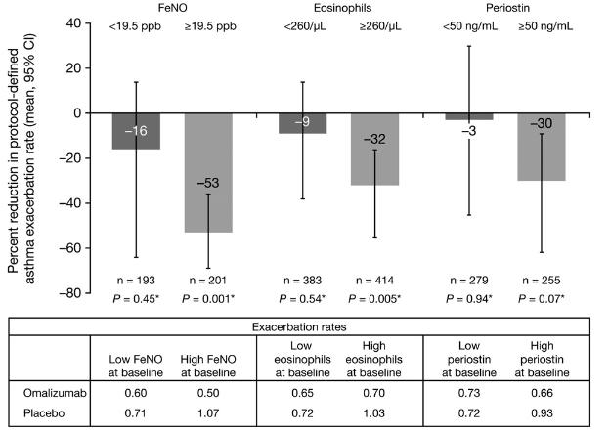
Asthma Therapy - Omalizumab
Th2 low versus Th2 high subgroups
Hanania Am J Respir Crit Care Med 2013;187(8):804-811.

Slide 40

STELLAIR
Results: Reduction in Asthma Exacerbation Rate According to bEOS Count and Serum IgE in Adults With Severe Allergic Asthma
Overall
IgE ≤ 75 IU/mL
IgE > 75 IU/mL
n = 346
n = 377
n = 64
n = 49
n = 263
n = 307
Study /
Safety Info
Humbert M, et al. Eur Respir J. 2018;51(5).

Slide 41
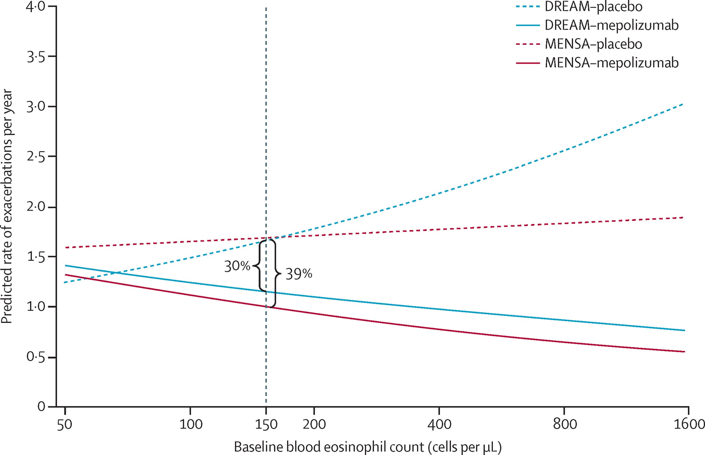
Mepolizumab Dream and Mensa studies

Slide 42
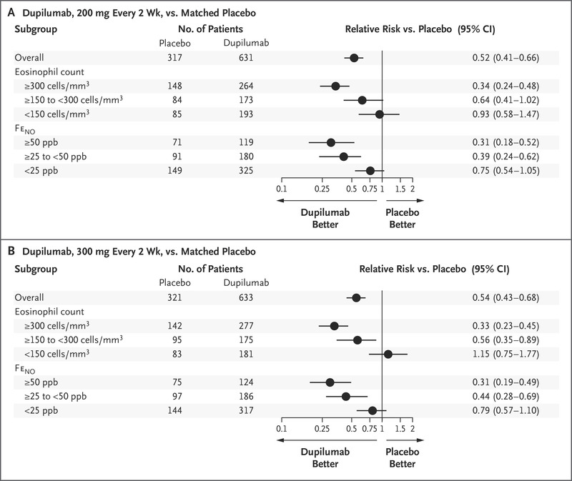
Dupilumab Liberty Asthma Quest

Slide 43
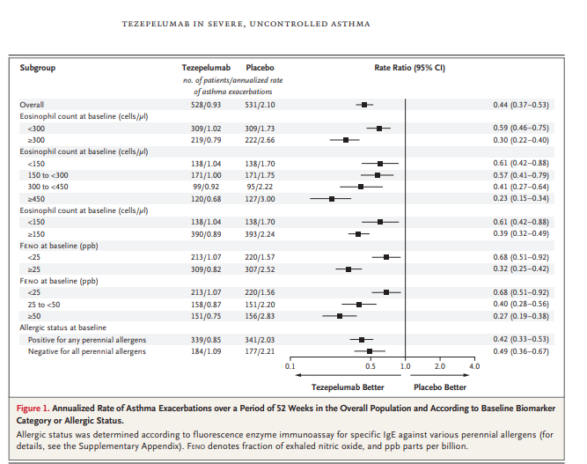
Tezepelumab

Slide 44
Mepo and Dupi response by biomarker
We undertook a post hoc analysis of a phase 2b study of mepolizumab in patients with severe eosinophilic asthma (DREAM)
We selected this study as it was the only mepolizumab study to assess FENO and blood eosinophils at baseline
To evaluate the relationship between biomarker profile and treatment efficacy, we compared our findings with published results of the phase 3 trial of monoclonal antibody dupilumab (QUEST)

Slide 45

Prognostic and Predictive Value of Blood Eosinophil Count, Fractional Exhaled Nitric Oxide, and Their Combination in Severe Asthma: A Post Hoc Analysis
Figure 1. Annualized exacerbation rates
Shrimanker et al;AJRCCM 2019;200:1308-12

Slide 46
Further Analysis of Dupilumab Studies
Post hoc analysis of the LIBERTY ASTHMA QUEST phase 3, randomized, placebo-controlled trial assessed the effect of add-on dupilumab treatment on:
annualized rates of severe exacerbations
lung function ( pre-bronchodilator FEV1)
asthma control (ACQ-5 score)
Evaluated subgroups of patients categorized by exacerbation history, i.e. ⩾1, ⩾2 or ⩾3 exacerbations in the year prior to study enrolment.

Slide 47
Further Analysis of Dupilumab Studies
The rationale for selecting these strata was based on the knowledge that recent exacerbations independently predict future exacerbation risk
Patients who have elevated type 2 biomarkers and/or are receiving high-dose ICS have more severe disease and are therefore at greater risk of asthma exacerbations

Slide 48
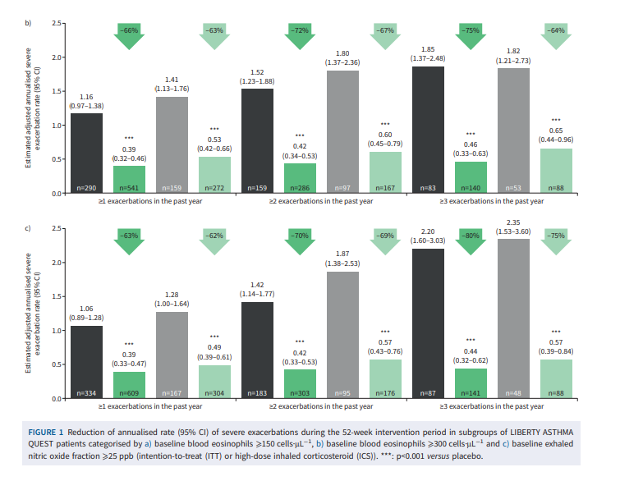

Slide 49
Further Analysis of Dupilumab Studies
Dupilumab significantly reduced severe exacerbations and improved FEV1 and asthma control in patients with elevated type 2 biomarkers irrespective of exacerbation history and baseline ICS dose.

Slide 50
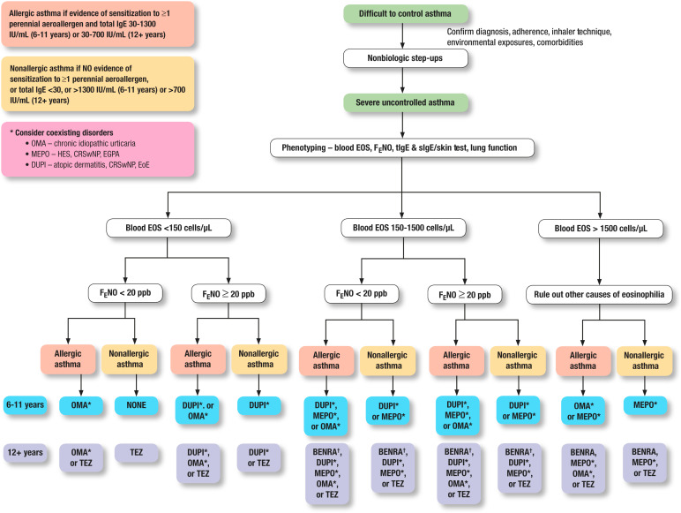
How to Choose Biologic for Asthma

Slide 51
Biologics in Asthma
Pathophysiology
What is severe asthma?
Current biologics
How to choose therapy
Switch therapy
Combine therapy and are biologics curative
Cases

Slide 52
Biologics in Asthma-Switching Therapy
Reasons to switch
Inadequate response to therapy (3-6 month trial)
Adverse events
Need for more convenient dosing schedule
Changes in insurance coverage
Other health conditions- pregnancy

Slide 53
Biologics in Asthma –Switching therapies
Multiple small case reports of switch from one biologic to others
Most omalizumab to mepolizumab
Also anti IL-5 to another anti IL-5
Also anti IL-5 to IL-4 receptor blocker
NO double blinded studies comparing biologics in asthma
Most studies show positive effect with change

Slide 54
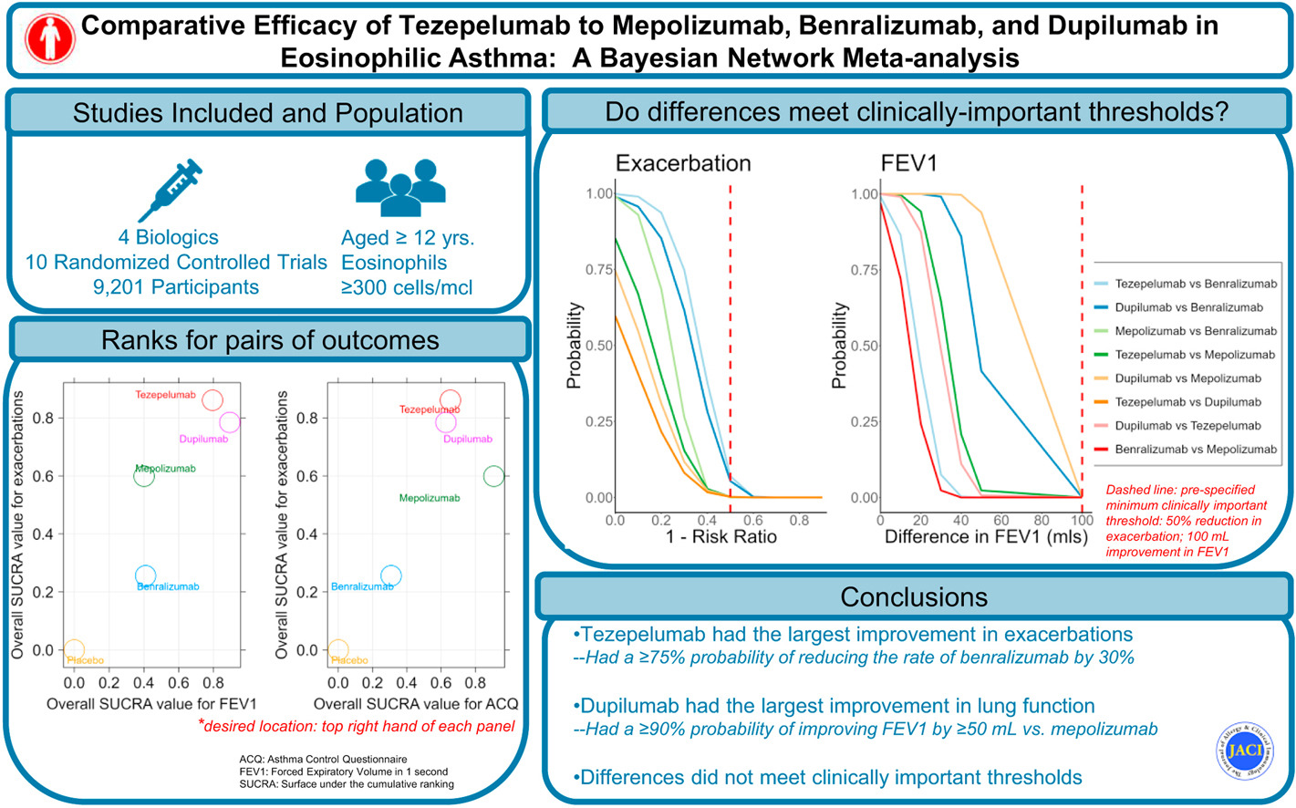

Comparing Biologics Bayesian Network Meta-Analysis

Slide 55
Comparing Tezepelumab to other biologics
For efficacy by clinically important thresholds
Tezepelumab, mepolizumab, and dupilumab achieved a >99% probability of reducing exacerbation rates by ≥50% compared to placebo
Benralizumab had only a 66% probability of doing so.
Tezepelumab and dupilumab had a probability of 1.00 of improving prebronchodilator FEV₁ by ≥100 mL above placebo.
Compared to mepolizumab, dupilumab had >90% chance for improving FEV₁ by ≥50 mL
None of the differences between biologics exceeded 100 mL.

Slide 56
Biologics in Asthma
Because no head-to-head comparisons have been made between these biologics, claims of superiority of one biologic over the other as made by indirect treatment comparisons using meta-regression and matching-adjusted strategies may be invalid and misleading

Slide 57
Biologics in Asthma
Pathophysiology
What is severe asthma?
Current biologics
How to choose therapy
Switch therapy
Combine therapy and are biologics curative
Cases

Slide 58
Biologics in Asthma -Combination therapy
Only a few case reports to date in using multiple biologics in asthma
OSMO (switch from omal to mepo) study did not show additional benefit in first half of study when both biologics were still present
Also, no decline was seen when Omalizumab washed out of system
Two other small studies showed similar results
Side effect profile was also not changed while using both
Risk benefits must be discussed with patients
Cost and insurance coverage would be major hurdle for use in practice

Slide 59
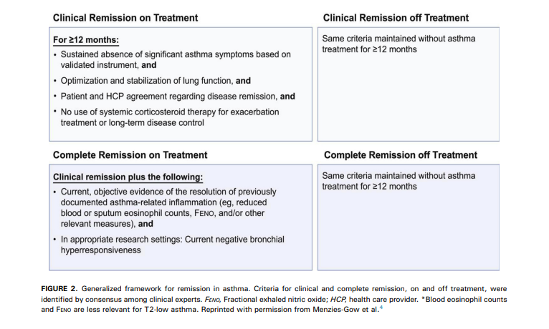
Biologics in Asthma
Can their use lead to disease remission?

Slide 60
Proposed Criteria to Discontinue Biologic Therapy
Absence of asthma symptoms (ACQ score <1.5 or ACT score >19)
No asthma exacerbations
No use of oral corticosteroids
Normalized spirometry (FEV1 ≥80%)
Suppressed Type 2 inflammation (blood eosinophil counts <300 μL and FeNO <50 ppb)
Control of comorbidities.

Slide 61
“Asthma clinical remission on treatment”
DRAFT definition from Workgroup
Patients must meet these parameters over a 12-month period, and they may be applied to a patient receiving monoclonal antibody therapy (biologic) .
1. NO exacerbations requiring physician visit, emergency care, hospitalization, and/or systemic steroid (oral, injectable)
2. NO missed work or school over a 12-month period due to asthma-related symptoms.
3. Stable and optimized pulmonary function results on all occasions measured over a 12-month period with a minimum of two measurements during the year.
4. Criteria will allow for continued use of controller (ICS, ICS/LABA, leukotriene receptor antagonist) ONLY at low-medium dose of ICS as defined by most recent GINA guidelines.
5. ACT >20, AirQ <2, ACQ<0.75 on all occasions measured in the previous 12-month period with a minimum of two measurements during the year.
6 Symptoms requiring one-time reliever therapy (SABA,ICS-SABA,ICS-LABA) no more than twice a year.

Slide 62
Biologics and Remission in Pediatric Asthma
Mepolizumab
  COLUMBA study showed 33% patients had no exacerbation over 3.5 years average duration
Benralizumab
  In BORA 56-week extension study 72% of patients had no exacerbations(Only in patients with Eos greater than 300)
Dupilumab
  LIBERTY study showed postbronchodilator FEV1 values at study’s completion showed a 40 mL loss of volume in the placebo-treated groups over the year-long study, but there was no loss of FEV1 with dupilumab.
  Whether this protective effect on lung function indicates that dupilumab prevents the progressive loss of lung function seen in asthma and represents a “remission” in disease progression is not established.

Slide 63
Remission with Mepolizumab?
Patients who stopped mepolizumab had a significantly shorter time to first clinically significant exacerbation than patients who continued; they had a 61% increase in the risk of experiencing their first clinically significant exacerbation (stopping/continuing mepolizumab hazard ratio (HR) 1.61, 95% CI 1.17–2.22; p=0.004) over the 52-week part C period.
A significantly higher proportion of patients who stopped mepolizumab (placebo group) experienced at least one clinically significant exacerbation during part C compared with those continuing mepolizumab treatment (59% versus 46%; OR 1.99, 95% CI 1.19–3.32; p=0.009.

Slide 64
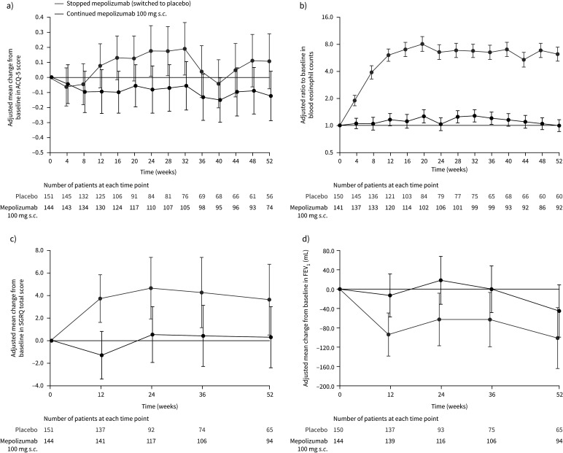
Remission with Mepolizumab?

Slide 65
Discontinuing Xolair
Recruited subjects who had been on Omalizumab for around 5 years
Subjects continuing Omalizumab had significantly better asthma control
Xport study followed patients for one year
  67% in Omalizumab group had no protocol-defined exacerbations
    Does this indicate remission?
  47.7% in Placebo group

Slide 66
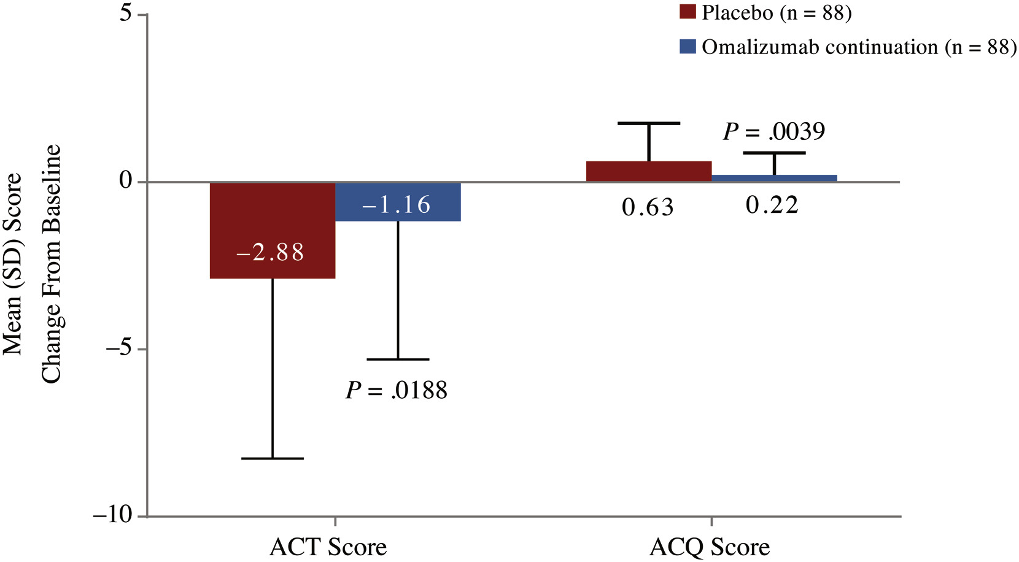
Xolair discontinuation Symptom scores

Slide 67
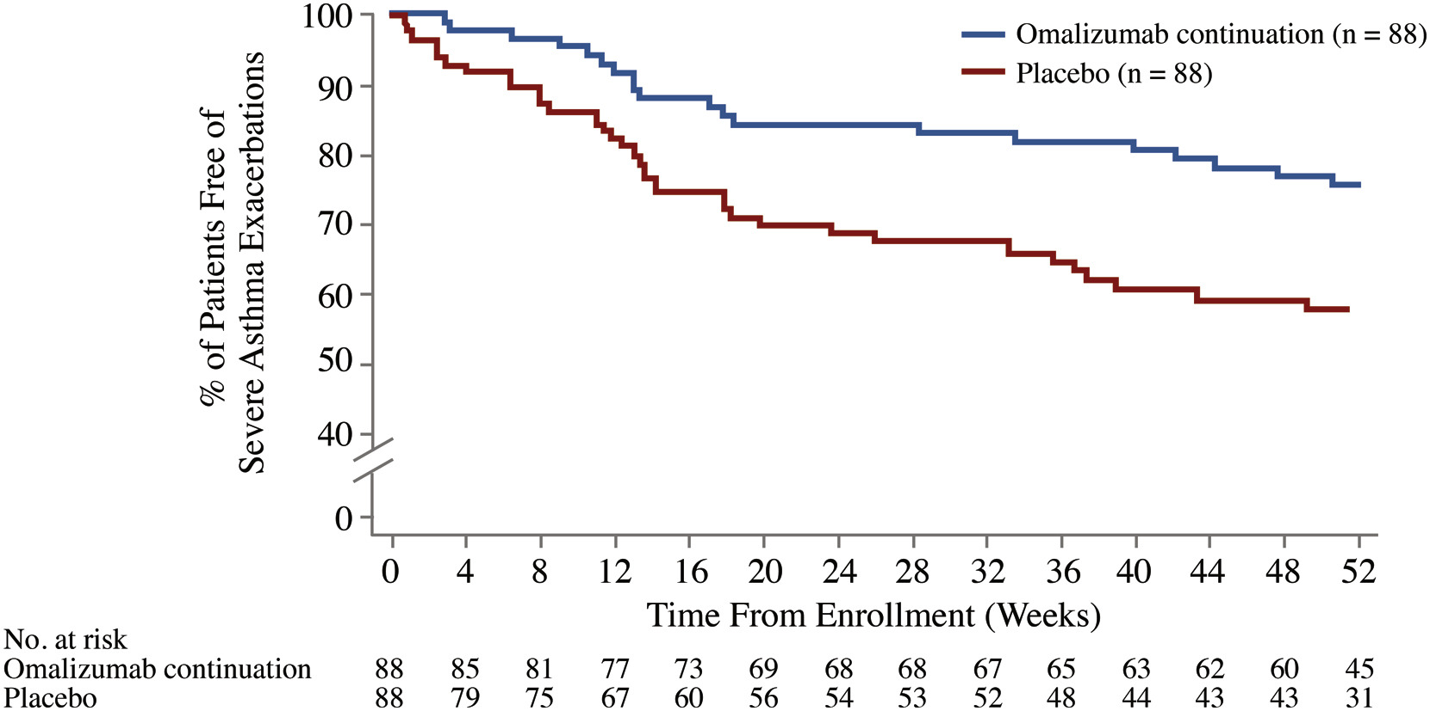
Time to first exacerbation after stopping Xolair

Slide 68
Quantitative and qualitative methods of evaluating response to biologics in severe asthma patients: Results from a real-world study
Adequate measurement of the response to biologics in a holistic manner that integrates clinical variables of interest and quality of life is needed, particularly in identifying super-responder patients (SR)
Upham et al. described a questionnaire to evaluate the achievement of clinical hallmarks, particularly trying to identify SRs.
At least 2 major criteria (exacerbation elimination, major improvement in asthma control, or cessation of maintenance oral corticosteroids [OCS]) and 1 minor criterion (75% exacerbation reduction, Asthma Control Test [ACT] >19, or ≥500 mL improvement in forced expiratory volume in the first second [FEV₁]) should be fulfilled.

Slide 69
Quantitative and qualitative methods of evaluating response to biologics in severe asthma patients: Results from a real-world study
Following the SR consensus criteria, 59.4% of the patients were considered SR and 40.6% were non-SR. According to the clinical data, the SR group showed an average FEOS score of 96.8% ± 7.6%, and the non-SR group showed an average score of 80.3% ± 16.8%.
This percentage of SRs in our series is high compared with similar real-world studies.
Two factors that could have influenced the ratio of SRs are the high mean levels of eosinophils and the presence of nasal polyposis (NP), which are the factors associated with better response to T2 biologics

Slide 70
Quantitative and qualitative methods of evaluating response to biologics in severe asthma patients: Results from a real-world study
The accurate assessment of the response to the biological therapies for severe asthma is essential, not only in case of poor response to the treatments but also to identify an optimal response.

Slide 71
Biologics and Remission in Pediatric Asthma
We can conclude, as a group, that current biologics are efficacious in achieving improved disease control in patients with severe disease with characteristics of T2 inflammation
They do not meet criteria for remission(definition still being refined) in all treated subjects, or all the criteria for remission at this point.

Slide 72
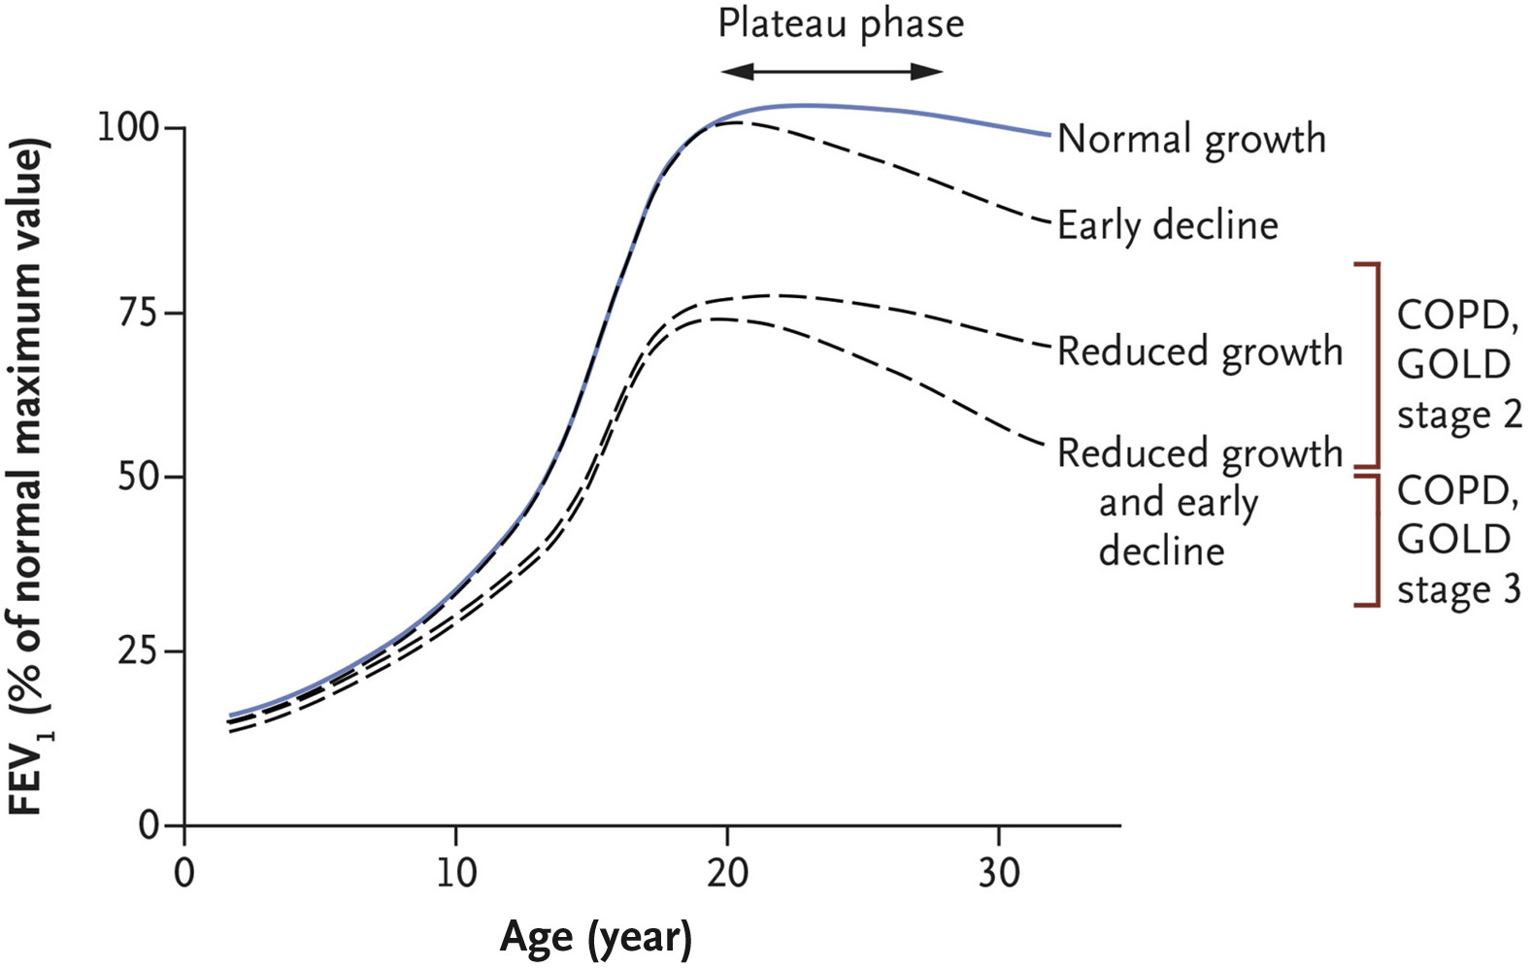
Should We Start Biologics Earlier?
Figure 6
Figure 6 Possible lung function trajectories during the first 3 decades of life are shown; the lung function plotted for each age is the percentage of the maximum FEV₁ in a person without lung disease; the maximum value is usually attained at the age of 18 to 30 years. A normal pattern of lung function growth and decline is characterized by a steep increase during adolescence, a plateau in early adulthood, and a gradual decline into old age. Abnormal trajectories include reduced growth, normal growth and an early decline, and reduced growth and an early decline.
)
Notes:
Possible lung function trajectories during the first 3 decades of life are shown; the lung function plotted for each age is the percentage of the maximum FEV1 in a person without lung disease; the maximum value is usually attained at the age of 18 to 30 years. A normal pattern of lung function growth and decline is characterized by a steep increase during adolescence, a plateau in early adulthood, and a gradual decline into old age. Abnormal trajectories include reduced growth, normal growth and an early decline, and reduced growth and an early decline. The red brackets indicate FEV1 criteria according to Global Initiative for Chronic Obstructive Lung Disease (GOLD) stage 2 (FEV1 ≥50% and <80%) and stage 3 (FEV1 ≥30% and <50%) of chronic obstructive pulmonary disease (COPD), when accompanied by a ratio of FEV1 to forced vital capacity that is less than 0.70. The figure is adapted from Speizer and Tager. Reprinted with permission from McGeachie et al.²²

Slide 73
Biologics in Pediatric Asthma
There are other studies in progress to evaluate the potential of medications to alter the natural history of asthma including:
  The Preventing Asthma in High-Risk Kids (PARK) study
    The PARK study will test whether anti-IgE administered in early child may alter the natural history of asthma
    A double blinded four-year study for children 24 - 47 months with the goal of identifying if injections of Omalizumab for two years, could prevent children from getting Asthma and lessen the severity of their breathing problems as they grow
  IDEA Study
    In this research study we want to learn if Dupilumab helps to control your asthma. We are particularly interested in understanding if people who have a certain genetic make-up (genotype) will respond better to this treatment

Slide 74
Can Dupilumab Attenuate the Atopic March?
We sought to determine the rate of acquisition of new or worsened allergic events for dupilumab versus placebo in patients with AD.
Allergy-associated events from 12 clinical trials were grouped into 17 allergy categories, and IgE changes from baseline were defined.
A new/worsened event was considered one step of atopic march.
The duration of pooled AD studies was 4 to 52 weeks (1359 patient-years; n = 2296 dupilumab, n = 1229 placebo, median age 35 years).

Slide 75
Can Dupilumab Attenuate the Atopic March?
Dupilumab reduced the risk of new/worsening allergies by 34% (IRR 0.66; 95% confidence interval [CI], 0.52-0.84) and new allergies by 37% (IRR 0.63; 95% CI, 0.48-0.83) versus placebo
Shifts in point estimates across subgroup analyses revealed that the treatment benefit of dupilumab appeared greater for younger patients (<18 years), those with early onset of AD (<2 years), those with more severe AD at baseline, and those with baseline asthma versus no asthma
A persistent, albeit attenuated, effect was observed with discontinuing dupilumab therapy in off-treatment periods; however, no rebound in allergic events was noted after dupilumab treatment had been discontinued, as evidenced by continued treatment benefits observed in follow-up periods after discontinuation of therapy.

Slide 76
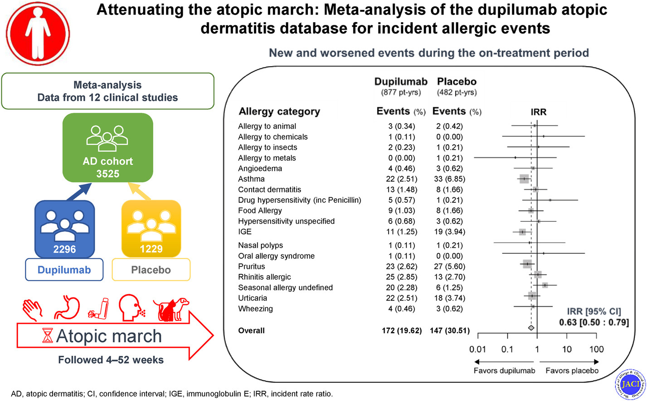
Can Dupilumab Attenuate the Atopic March?

Slide 77
Biologics and Remission in Pediatric Asthma
No data at this point that biologics ”cure” asthma
  Patients typically worsen when medications are stopped
Could biologics reverse lung function decline that starts in pediatric patients?
Future trials needed to investigate this

Slide 78
Biologics in Asthma
Conclusions
At the present time we have no definitive biomarkers that direct therapy but using biomarker for guidance may help improve outcomes
No good data to show one biologic will work better than another but it appears all biologics work better when Eosinophil counts are higher(will Tezepelumab be beneficial despite low eosinophil count??)
Multiple studies show switching biologic therapies may improve patients
Not enough data to make statement regarding combining therapies

Slide 79
Biologics in Asthma –Switching therapies
Conclusions
We need comparative studies and research into more reliable biomarkers
Will the future be even more patient specific treatments based on new still undefined patient biomarkers??

Slide 80
Biologics in Asthma
Pathophysiology
What is severe asthma?
Current biologics
How to choose therapy
Switch therapy
Combine therapy and are biologics curative
Cases

Slide 81
Biologics in Asthma- Cases
Case 1
Patient with allergic sensitization to environmental aeroallergens and worsening of symptoms from aeroallergen exposures. Her total serum IgE level is 500 IU/mL. This patient has strong grass allergies and notes that asthma exacerbations typically occur in the summertime. Her evaluation results reveal absolute eosinophil count (AEC) of 200 cells/mcL FeNO 22 ppb.

Slide 82
Biologics in Asthma- Cases
Choice
Omalizumab
Discussion
For this patient with strong clinically relevant allergic sensitization to environmental aeroallergens, no evidence of marked eosinophilic inflammation, and low FeNO, IgE or allergic sensitization seems to be the dominant biomarker. Omalizumab would be the first choice; however, if the patient fails to achieve benefits, anti–IL-5/5R or anti–IL-4Ra strategies could be helpful.

Slide 83
Biologics in Asthma- Cases
Case 2
Patient with AEC 800 cells/mcL, 5% sputum eosinophils, FeNO 35ppb, and total serum IgE 300 IU/mL. He has allergic sensitization to a couple of trees only but notes no seasonal variation in his respiratory symptoms or known environmental triggers.

Slide 84
Biologics in Asthma- Cases
Choice
Anti–IL5/5R, Anti TSLP
Discussion
For this patient with eosinophilic asthma, relatively low FeNO, and allergic sensitization that does not seem to be a clinically dominant feature, eosinophilia seems to be the dominant biomarker. Although anti–IL-5/5R therapy would be our first choice, given the role of anti–IL-4Ra in preventing eosinophil trafficking and its efficacy in this population, dupilumab would be a reasonable alternative, unless there was a history of markedly high eosinophilia, such as more than 1000 to 1500 cells/mcL. There are no compelling data suggesting any anti–IL-5/5R therapy is better than another.

Slide 85
Biologics in Asthma- Cases
Case 3
Patient with AEC 300 cells/mcL, FeNO 85ppb, and total serum IgE 500 IU/mL. He has sensitization to pollens and animal dander and notes perennial respiratory issues. He notes great response to OCS bursts.

Slide 86
Biologics in Asthma- Cases
Choice
Dupilumab.
Discussion
He would qualify for anti–IL-5/5R, anti-IgE, and anti–IL-4Ra. Our initial choice would be dupilumab given the milder eosinophilic inflammation and allergic sensitization without clinical dominance. Of note, elevation in total serum IgE is not a strong predictor alone of an allergic phenotype.²
The elevated FeNO level indicates high activity of the IL-13 pathway and both IL-4 and IL-13 mediate IgE production and eosinophil recruitment.
Dupilumab targets both IL-4 and IL-13 pathways and has broad effects beyond just eosinophils or IgE.

Slide 87
Biologics in Asthma- Cases
Case 4
Patient with AEC 400 cells/mcL, allergic sensitization to environmental aeroallergens, FeNO 42ppb, sputum and BAL eosinophils 1%, and total serum IgE 120 IU/mL. She has sensitization to animal dander, and she reports worsening respiratory symptoms around animals. Nevertheless, she notes that she has asthma exacerbations not obviously triggered by her allergies.

Slide 88
Biologics in Asthma- Cases
Choice
Any biologic.
Discussion
There is no single dominant biomarker. She has moderate blood eosinophilia without evidence of tissue eosinophilia, slightly elevated FeNO, and clinically relevant allergic sensitization that is not sufficient to explain all of her asthma exacerbations.
Evaluation of historical values may be helpful to elucidate which pathway may be a stronger driver. For instance, if she were noted to have had blood eosinophils ranging from 400 to 1200 cells/mcL in the previous few months, anti–IL-5/5R would be appropriate. If a given therapy fails to achieve success, another could be tried.

Slide 89
Biologics in Asthma- Cases
Case 5
Patient on maintenance OCS for years with inability to taper. A previous taper attempt led to an exacerbation requiring hospitalization. Although on prednisone, her AEC is 0, BAL eosinophils are 0%, FeNO is 20 ppb, total serum IgE is 130 IU/mL, and she has no history of atopy or allergic sensitization.

Slide 90
Biologics in Asthma- Cases
Choice
Dupilumab.
Discussion
Indication of dupilumab for corticosteroid-dependent asthma allows for use in patients who have difficulty tapering down maintenance OCS for evaluation of potential inflammatory phenotypes. Although she does not qualify for other asthma biologic therapeutics, data from OCS studies with mepolizumab and benralizumab suggest that either of these could be effective if there were any history of systemic eosinophilia

Slide 91
Biologics in Asthma- Cases
Case 6
Patient on dupilumab. He had initial good response of his asthma and atopic dermatitis but has had recurrent exacerbations in the previous year that remain refractory to improved management of his comorbidities and adherence. Re-evaluation reveals blood eosinophils of 200 cells/mcL, FeNO 15 ppb (before dupilumab was 55 ppb), and environmental aeroallergen sensitization. BAL has 11% eosinophils.

Slide 92
Biologics in Asthma- Cases
Choice
Switched to anti–IL-5/5R(tezepelumab).
Discussion
Discordance between systemic and airway eosinophilia is not uncommon.
This patient has marked airway without blood eosinophilia while on dupilumab. Given this and his clinical loss of response, we would switch to an anti–IL-5/5R to target eosinophilic inflammation.
Given the lack of safety data of dual-biologic therapy, and its high cost, we would switch rather than add-on in this case.

Slide 93
Biologics in Asthma- Cases
Case 7
Patient on benralizumab. She had initial considerable clinical improvement, but in the previous year, has had worsened symptoms and repeated exacerbations despite re-evaluation and management of medication adherence and comorbidities. She has blood eosinophils of 0 cells/mcL (before benralizumab ranged from 300 to 600 cells/mcL), environmental aeroallergen sensitization with corresponding seasonal triggers, sputum eosinophils of 0%, and FeNO of 77 ppb.

Slide 94
Biologics in Asthma- Cases
Choice
Switched to dupilumab(? tezepelumab).
Discussion
Despite no evidence of systemic or airway eosinophilia, this patient seemed to lose response to benralizumab. Her elevated FeNO level and clinically relevant history of environmental allergies lead us to choose dupilumab.

